Slide 1
Reconstructing drug trafficking evidence from web history
cryptocurrency, Chrome History Investigations

Slide 2
Overview
Background
Drug trafficking using craiglist.org as a communication platform
You need to retrieve drug trafficking evidence from web history
Lab
Download the case web history
Examine web history database structures
Create a timeline of illegal activities based on web history

Slide 3
Background

Slide 4
Scenario
A suspect uses online platform to sell illegal drugs
Post drug information
Schedule illegal transaction location and date
Exchange payment information
The suspect uses Chrome browser
You are given a Chrome history file
Your goal
Retrieve drug trafficking evidence from web history
Create a timeline of illegal activities based on evidence

Slide 5
Lab (part 1): Download the case web history

Slide 6
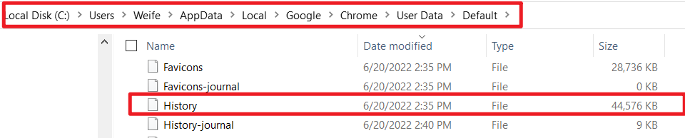
Location of Chrome history logs
Chrome history is stored in an SQLite database, the filename is History and can be found in the following locations:
Microsoft Windows Vista, 7, 8, 10
C:\Users\<username>\AppData\Local\Google\Chrome\User Data\Default\History
Linux/Unix
/home/<username>/.config/google-chrome/Default/History
macOS
/Users/<username>/Library/Application Support/Google/Chrome/Default/History
Notes:
https://docs.nxlog.co/userguide/integrate/browser-history.html#:~:text=Microsoft%20Edge%20browsers.-,Google%20Chrome%20history%20location%20and%20details,%5CChrome%5CUser%20Data%5CDefault

Slide 7
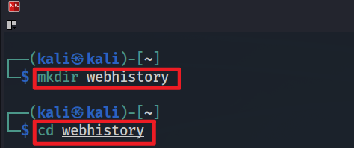
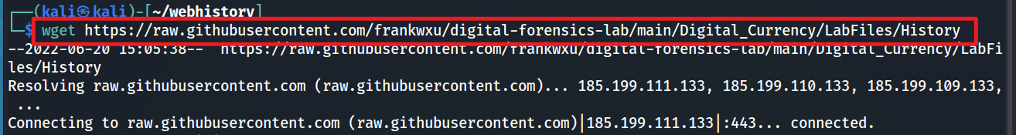
Download History
Create a lab folder
Download web History
Verify the file
Notes:
wget https://raw.githubusercontent.com/frankwxu/digital-forensics-lab/main/Digital_Currency/LabFiles/History

Slide 8
Lab (part 2): Examine web history database structures

Slide 9
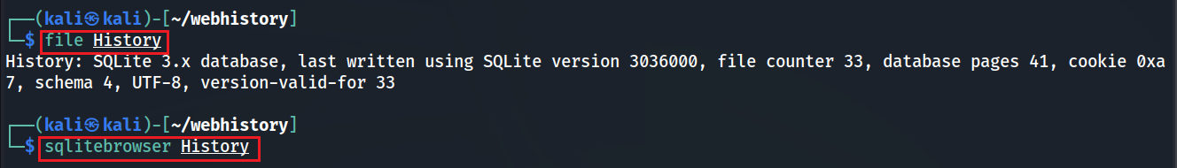
Exam main tables of History
Check file type and show tables

Slide 10
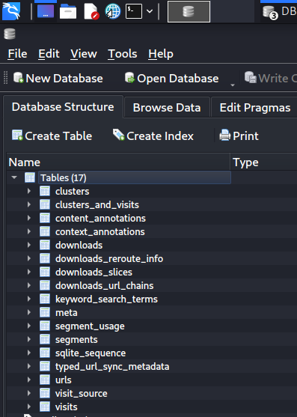
As seen in DB Browser
File type, save location, and other download details
together to retrieve the URL, page title, and time it was accessed.
Stores visited URLs, including page titles, and when was the last time the URL was visited
Stores each visit to a URL, including when the URL is visited and how long a user stay on the page

Slide 11
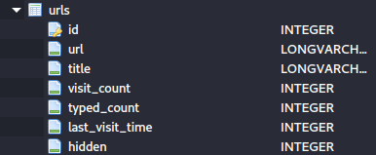
urls table structure
User visited urls
Column | Type | Description
id | INTEGER | Primary Key - a unique ID for the record
url | LONGVARCHAR | The URL that was accessed
title | LONGVARCHAR | The title of the website
visit_count | INTEGER | The number of times the URL was accessed
typed_count | INTEGER | The number of times the user got to this website by typing the URL in the address bar
last_visit_time | INTEGER | Webkit/Chrome Timestamp in nanoseconds when the website was last visited
Webkit/Chrome: microseconds since Jan 1, 1601 00:00 UTC
Unix/Epoch time: second since 1 January 1970 00:00 UTC
diff (Unix timestamp – webkit time/1,000,000) = 369 years =11644473600 seconds
Notes:
https://docs.nxlog.co/userguide/integrate/browser-history.html#:~:text=Microsoft%20Edge%20browsers.-,Google%20Chrome%20history%20location%20and%20details,%5CChrome%5CUser%20Data%5CDefault

Slide 12
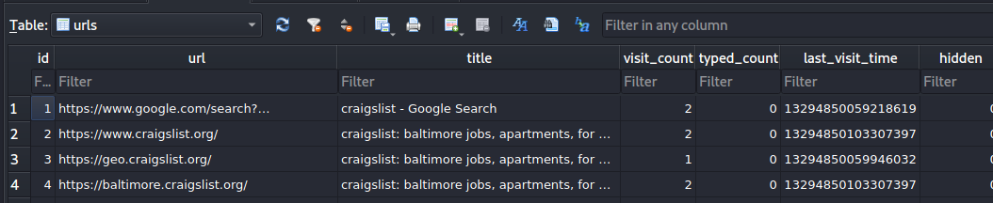
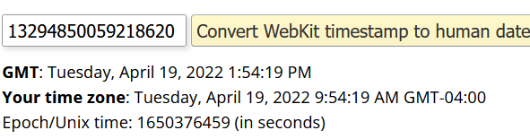
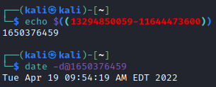
Total times URL typed into address bar for visit
Show example records of urls
Total visits
Last time URL visited
Format is in WebKit: use https://www.epochconverter.com/webkit
Or use

Slide 13

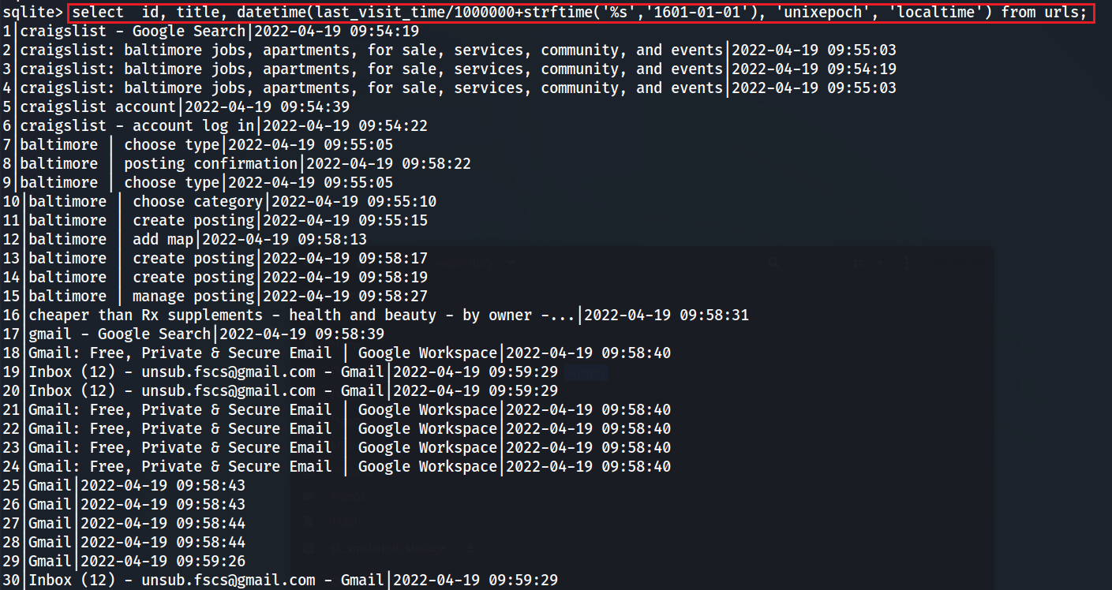
Show id, title, and date of urls using sql language
url column is ignore because the content is too long and it will mess up the format
Notes:
select id, title, datetime(last_visit_time/1000000+strftime('%s','1601-01-01'), 'unixepoch', 'localtime') from urls;

Slide 14
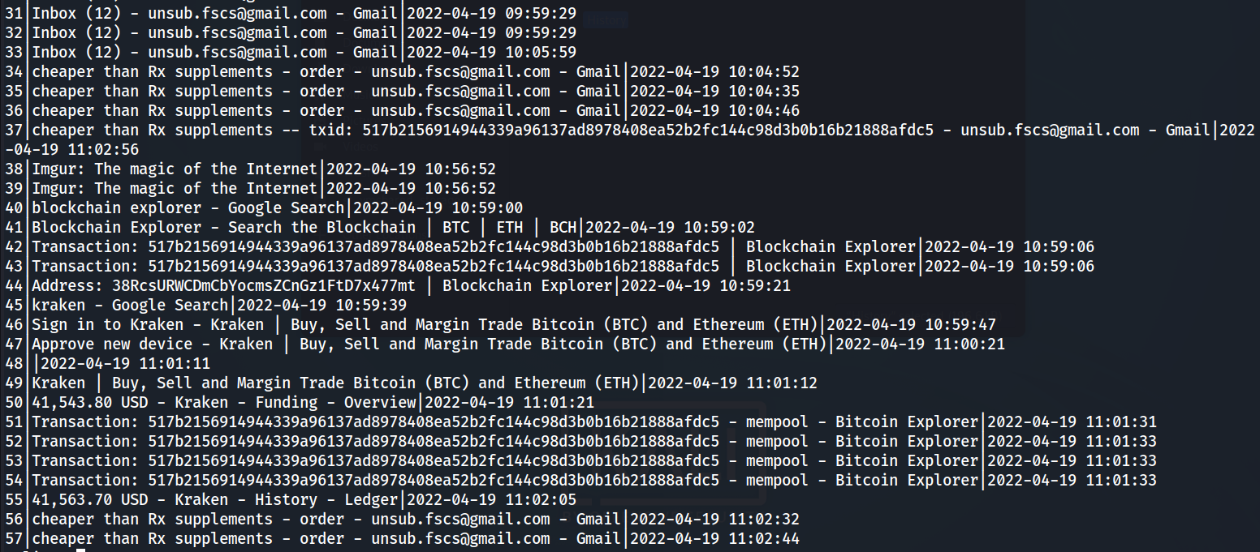

Slide 15
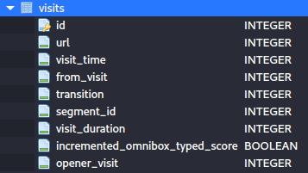
visits table structure
How was a URL visited?
Column | Type | Description
id | INTEGER | A unique ID for the record
url | INTEGER | An ID corresponding to a record in the urls table
visit_time | INTEGER | Timestamp in nanoseconds when the website was visited
from_visit | INTEGER | From which url (ID) the current url visited
transition | INTEGER | A value (code) identifies the type of transition between pages
visit_duration | INTEGER | Duration of visit in microseconds

Slide 16

from_visit and transition
current record in url table
www.google.com
www.cnn.com
click a link
user got to cnn.com by clicking a link on google.com
a corresponding record in visits table

Slide 17
Chrome Transition Types
ID | Type | Description
0 | Link | user got to this page by clicking a link on another page
1 | Typed | user got to this page by typing the URL in the URL bar
2 | Auto Bookmark | user got to this page through a suggestion in the UI
3 | Auto Subframe | This is a subframe navigation. For example, if a page consists of several frames containing ads, those ad URLs will have this transition type. The user may not even realise the content in these pages is a separate frame, so may not care about the URL
4 | Manual Subframe | For subframe navigations that are explicitly requested by the user and generate new navigation entries in the back/forward list.
5 | Omnibar Generated | User typed search key in search bar and chosen from keywords generated by the search engine
6 | Top Level / Start page | The page was specified in the command line or is the start page.
7 | Form Submit | user filled out values in a form and submitted it.
8 | Reload / Restore | user "reloaded" the page, either by hitting the reload button or by hitting enter in the address bar
9 | Keyword | url was generated from a keyword or Omnibar Generated keyword
10 | Keyword Generated | corresponds to a visit generated for a keyword
Notes:
https://kb.digital-detective.net/display/BF/Page+Transitions
https://dfir.blog/chrome-transition-values/
https://source.chromium.org/chromium/chromium/src/+/main:ui/base/page_transition_types.h?q=page_transition_types.h

Slide 18
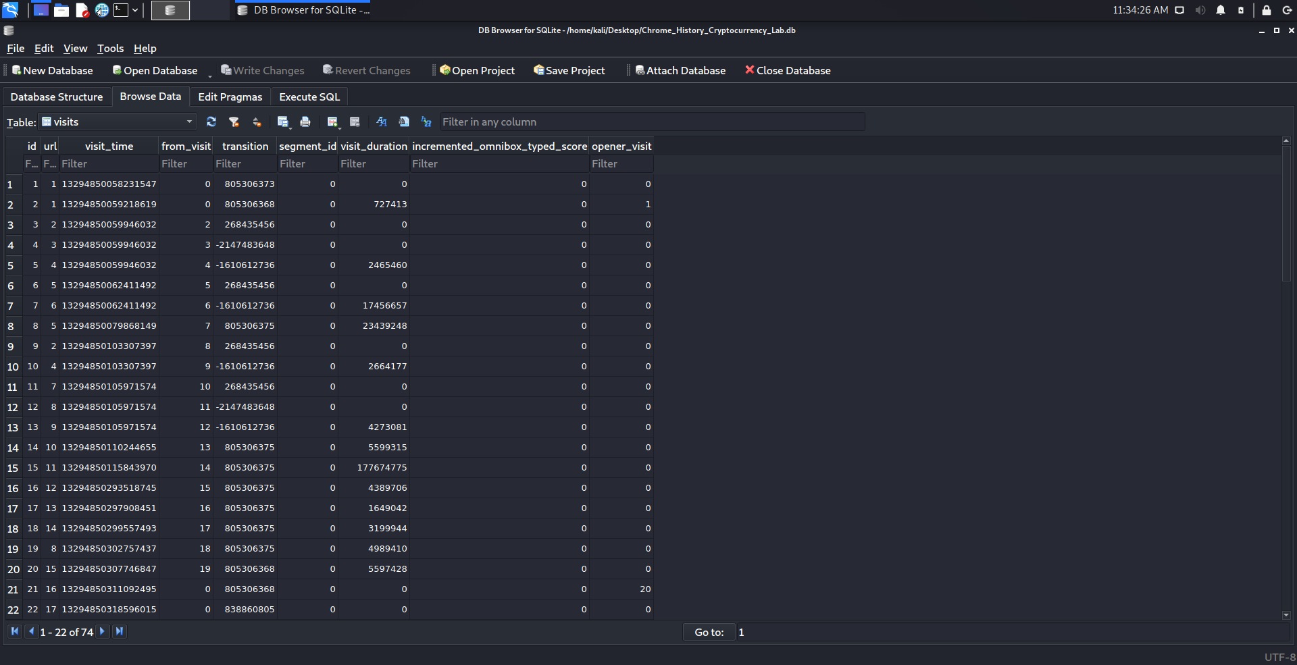
Show sample records of visits table
References urls entries
Timestamp
References visits entries
Duration of visit in microseconds
visited url 1 twice
This tells how URL was reached (link clicked, URL typed, form submitted, etc.) – more detail later

Slide 19
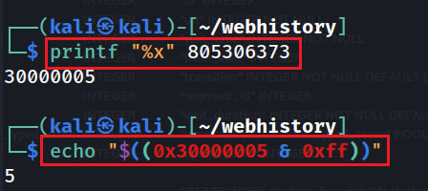
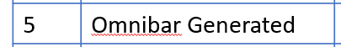
Calculate transition type of first url (id=1)
Calculate Steps
Convert decimal to hex
AND the value with 0xFF
Look up value in transition table
Notes:
echo "$((0x30000005 & 0xff))“
printf "%x" 805306373
For learning how to calculate: https://dfir.blog/chrome-transition-values/
For documentation: https://source.chromium.org/chromium/chromium/src/+/main:ui/base/page_transition_types.h?q=page_transition_types.h

Slide 20
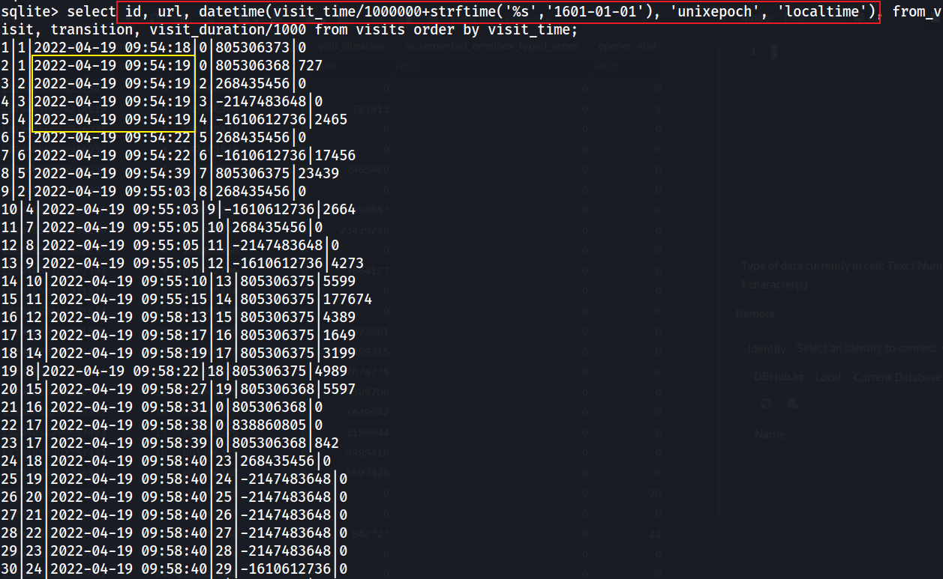
Convert timestamps in visits table to a readable format using sql statement
Notes:
select url, datetime(visit_time/1000000+strftime('%s','1601-01-01'), 'unixepoch', 'localtime'), from_visit, transition, visit_duration/1000 from visits order by visit_time;

Slide 21
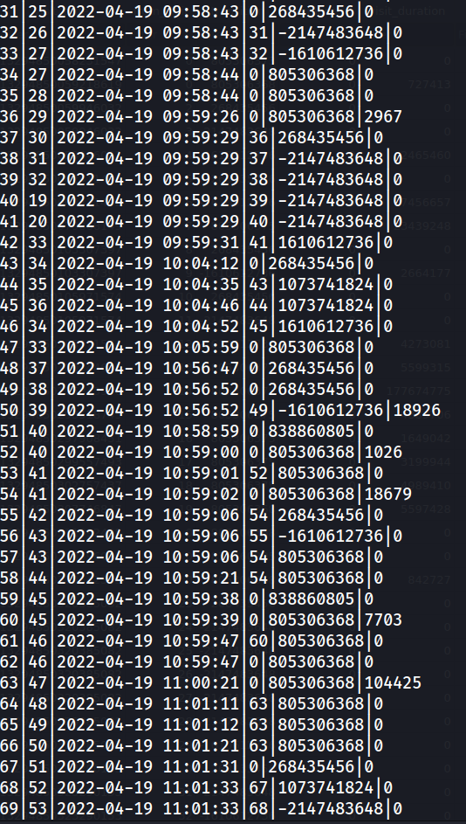

Slide 22
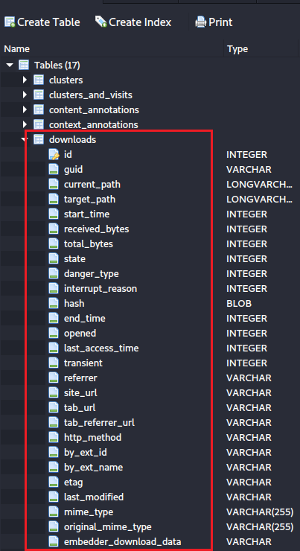
downloads table structure
Chrome Downloads are stored in the 'History' SQLite database, within the 'downloads' and 'downloads_url_chains' tables.
Notes:
https://www.foxtonforensics.com/browser-history-examiner/chrome-history-location

Slide 23
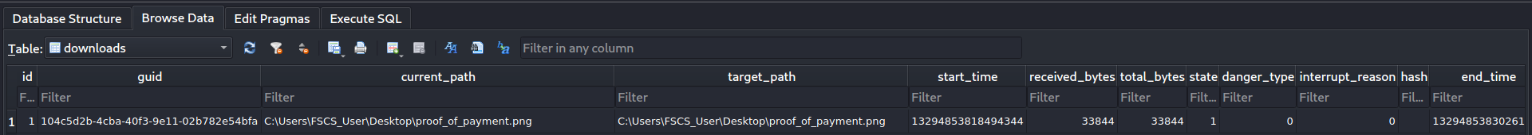
A sample downloads table
Type of dangerous file
Globally Unique Identifier
File location
File size
Download start time
Download start time
Status
SHA256 hash
Type of interruption
Total bytes downloaded as of acquisition
Notes:
https://source.chromium.org/chromium/chromium/src/+/main:components/download/public/common/download_danger_type.h
https://source.chromium.org/chromium/chromium/src/+/main:components/download/public/common/download_interrupt_reason_values.h
https://source.chromium.org/chromium/chromium/src/+/main:components/download/public/common/download_item.h

Slide 24
Open/Close state
Transient state
HTTP method used
Entity tag
MIME types
Last time opened
Download source
If downloaded by extension
Last time file modified server-side
Notes:
https://source.chromium.org/chromium/chromium/src/+/main:components/download/public/common/download_danger_type.h
https://source.chromium.org/chromium/chromium/src/+/main:components/download/public/common/download_interrupt_reason_values.h
https://source.chromium.org/chromium/chromium/src/+/main:components/download/public/common/download_item.h
https://source.chromium.org/chromium/chromium/src/+/main:components/history/core/browser/download_row.h?q=site_url

Slide 25
Lab (Part 3): Create a timeline of illegal activities based on visits

Slide 26
Hypothesis
Suspected drug dealer posted ad on a website listing sale of illegal drugs
Interested buyer messaged dealer
Dealer replied with transaction details (Bitcoin wallet)
Buyer sent payment
Dealer confirmed payment received
Dealer shipped drugs
Buyer received drugs

Slide 27
Analysis strategy
Segment visit records based on visit_duration
label each segment as Seg 1 , 2, …
visit_duration=0 indicates a redirect
For each segment
Exam visit records information
Join visits and urls based on the visit record
Interpreter each fields of joined visits and urls

Slide 28
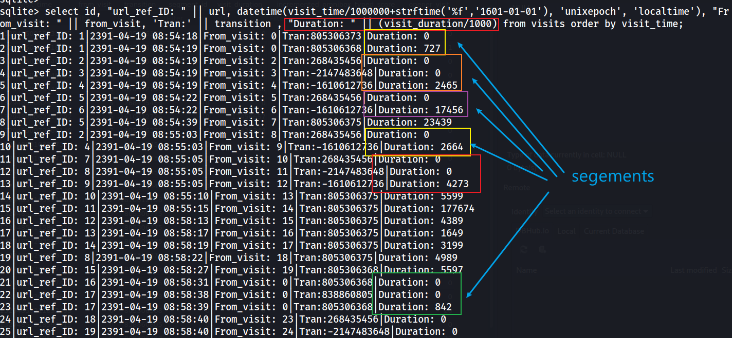
Segment visit records
concatenate strings for readability: string 1 || string 2
2
1
3
based on visit_time
4
5
Notes:
select id, "url_ref_ID: " || url, datetime(visit_time/1000000+strftime('%s','1601-01-01'), 'unixepoch', 'localtime'), "From_visit: " || from_visit, 'Tran:' || transition , "Duration: " || (visit_duration/1000) from visits order by visit_time;

Slide 29
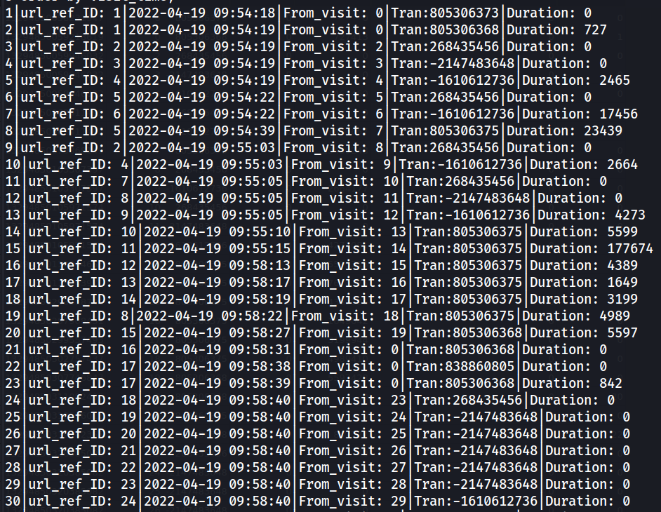
Seg1: Search “craiglist” (visit id=1-2)
5:Omnibar Generated
0:Link (sent/click a link)
join with url reference ID
Google search pattern: craigslist is a keyword
Visit ID | Date | Description | Duration (in second)
1 | Tue Apr 19 09:54:18 AM EDT 2022 | User typed “craiglist” into Chrome address bar and generate a URL | 0 (indicate a redirect)
2 | Tue Apr 19 09:54:19 AM EDT 2022 | Without any delay (duration =0), Chrome sends the URL to Google and google returns results in web page with the title “craigslist - Google Search” | User stayed in the page for 0.727 second
Notes:
select "url_id: " || id, url, title from urls where id=1;

Slide 30
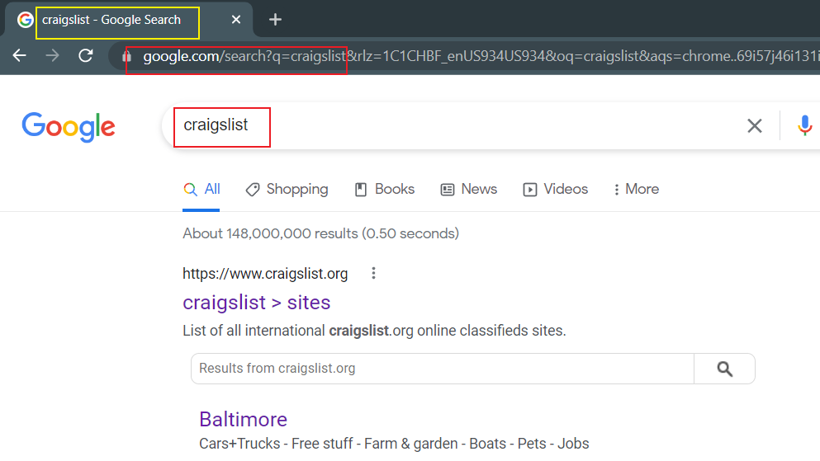
We can verify these URLs and transitions by either reproducing the steps on our device or visiting the actual URL from the database
5:Omnibar Generated

Slide 31
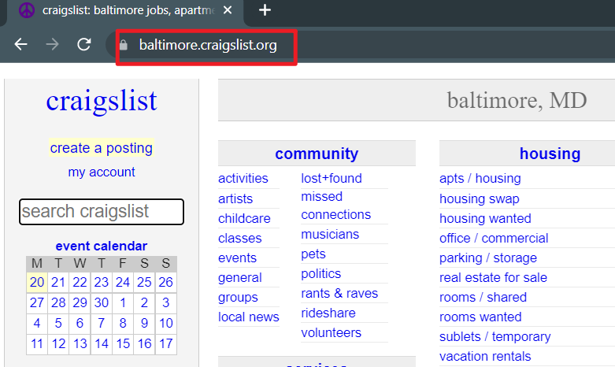
Craigslist.org
is an American classified advertisements website with sections devoted to jobs, housing, for sale, items wanted, services, community service, gigs, résumés, and discussion forums (wiki).

Slide 32
Seg2: Jump to https://www.craigslist.org/ (visits id=3-5)
0: Link
0x80000000: Link and server redirect
0: Link
Visit ID | Date | Description | Duration (in second)
3-5 | Tue Apr 19 09:54:19 AM EDT 2022 | User clicked a the link (from visits.id=2) and visited https://www.craigslist.org/. However, it was redirected to |https://geo.craigslist.org/ and https://baltimore.craigslist.org/ | User stayed in the page https://baltimore.craigslist.org/ for 2.465 second
Notes:
select "url_id: " || id, url, title from urls where id=2 or id=3 or id=4;
printf "%x" -2147483648
echo "$((0x80000000 & 0xff))“
https://source.chromium.org/chromium/chromium/src/+/main:ui/base/page_transition_types.h?q=page_transition_types.h

Slide 33
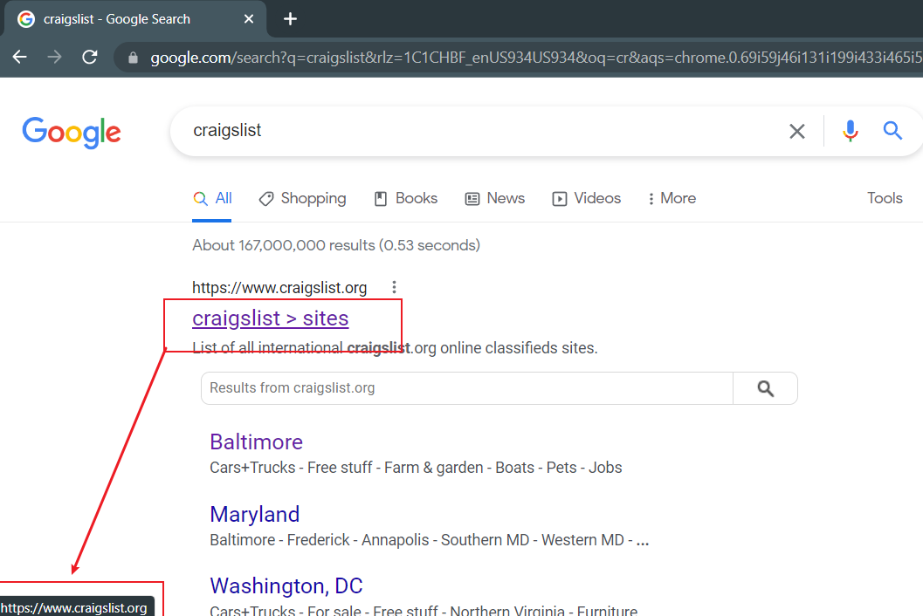
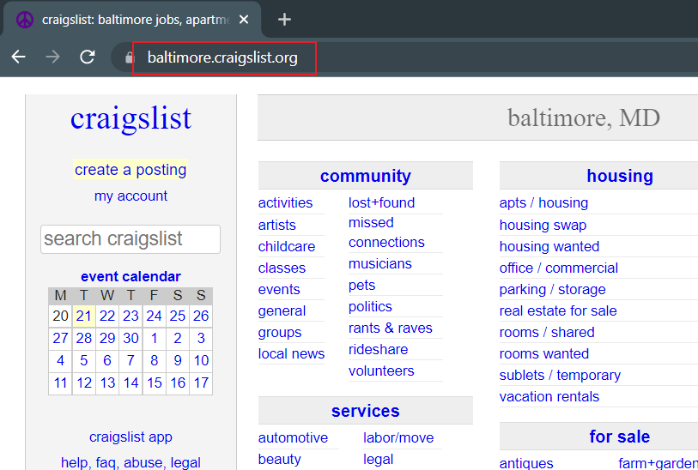
Verify click and redirects
0: Link

Slide 34
Analyze segment 3 (visits id=6-7)
0: Link
0: Link and server redirect
Visit ID | Date | Description | Duration (in second)
6-7 | Tue Apr 19 09:54:22 AM EDT 2022 | User click an account link https://accounts.craigslist.org/login/home in order to log in. User was redirected to another link https://accounts.craigslist.org/login?rp=%2Flogin%2Fhome&rt=L | User stayed in the page https://post.craigslist.org/c/bal for 17 second
Notes:
select "url_id: " || id, url, title from urls where id=5 or id=6;

Slide 35
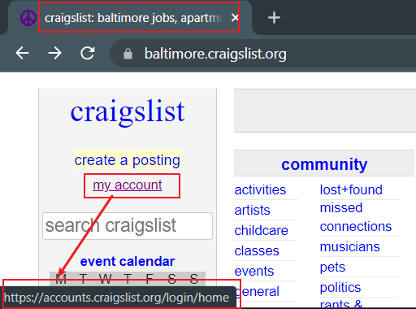
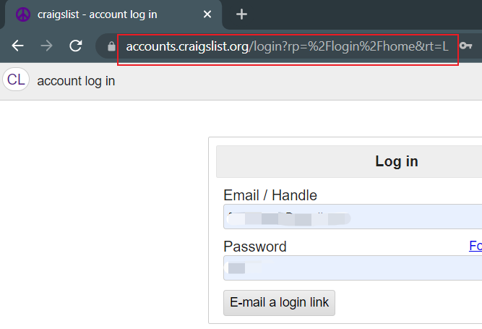
Verify click and redirects
0: Link

Slide 36
Analyze segment 4 (visits id=8)
7: Form Submit
Visit ID | Date | Description | Duration (in second)
8 | Tue Apr 19 09:54:39 AM EDT 2022 | User filled out the form (login) and submitted | User stayed in the page for 23 second
Notes:
printf "%x" 805306375
30000007
echo "$((0x30000007 & 0xff))“
7
select "url_id: " || id, url, title from urls where id=5;

Slide 37
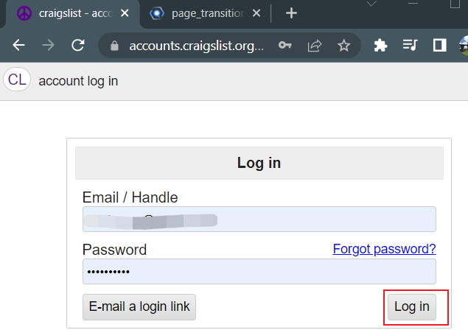
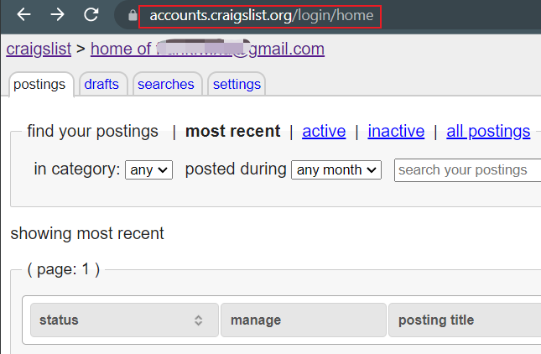
Verify form submission
7: Form Submit

Slide 38
Analyze segment 5 (visits id=9-10)
0: Link and Chain Start
Visit ID | Date | Description | Duration (in second)
9-10 | Tue Apr 19 09:55:03 AM EDT 2022 | User clicked a link https://www.craigslist.org/ and was redirected to https://baltimore.craigslist.org/ | User stayed in the page for 2 second
Notes:
printf "%x" 268435456
10000000
// The beginning of a navigation chain.
PAGE_TRANSITION_CHAIN_START = 0x10000000,
echo “$((0x10000000 & 0xff))”
0
select "url_id: " || id, url, title from urls where id=2 or id=4;

Slide 39
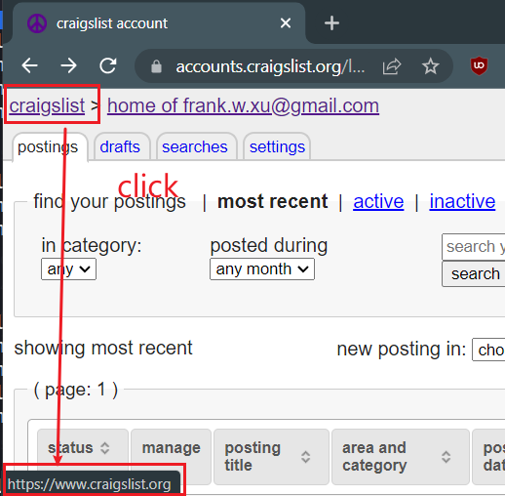
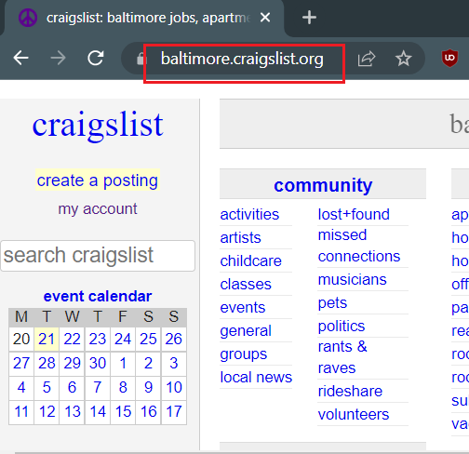
Verify click and redirect
0: Link

Slide 40
Analyze segment 6 (visits id=11-13)
0: Link and Chain Start
0: Link and Server Redirect
0: Link
Visit ID | Date | Description | Duration (in second)
11-13 | Tue Apr 19 09:55:05 AM EDT 2022 | User clicked a link (create a posting) https://post.craigslist.org/c/bal User was redirected to url_id 8 to posting confirmation User then redirect to url_id 9 to choose type | User stayed in the page url_id 9 for 4 second
Notes:
printf "%x" 268435456
10000000
echo “$((0x10000000 & 0xff))”
0
printf "%x" -2147483648
ffffffff80000000
echo “$((0x80000000 & 0xff))”
0
printf “%x” -1610612736
ffffffffa0000000
0
select "url_id: " || id, url, title from urls where id between 7 and 9;

Slide 41
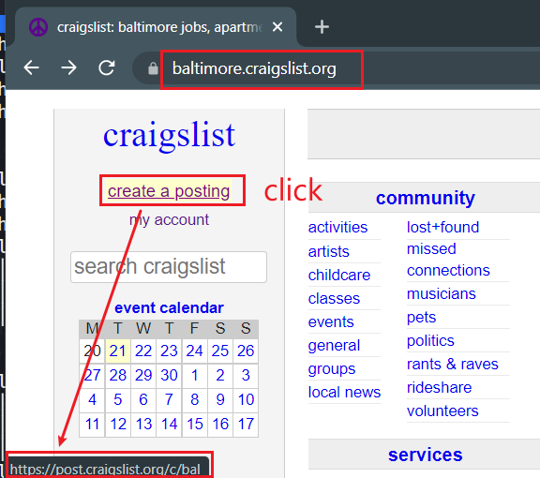
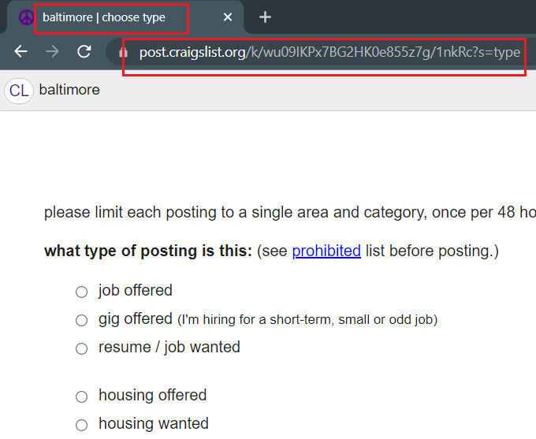
Verify click “create a posting” and redirect. Verify titles
0: Link

Slide 42
Analyze segment 7 (visits id=14)
7: Form Submit
Visit ID | Date | Description | Duration (in second)
14 | Tue Apr 19 09:55:10 AM EDT 2022 | User filled out the form (chose types) and submitted it User needs to choose category – query bqTi5?s=cat for category | User stayed in the page for 5 second
Notes:
printf "%x" 805306375
30000007
echo “$((0x30000007 & 0xff))”
7
select "url_id: " || id, url, title from urls where id=10;

Slide 43
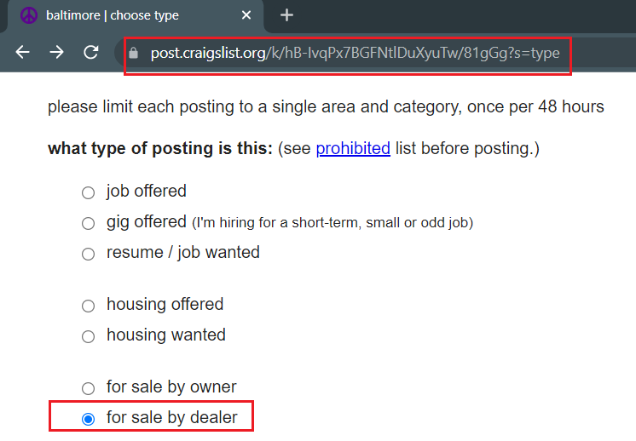
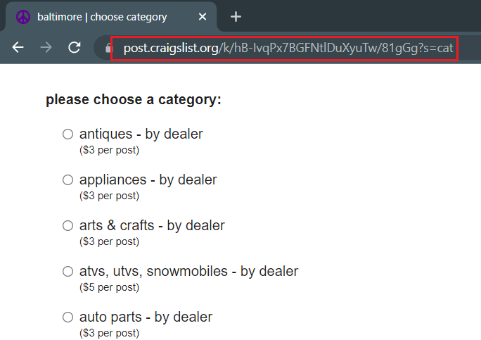
When reproduced, our string ID is different from suspect
But the structure of <stringID>/<stringID2>?s=cat is the same
7: Form Submit
click

Slide 44
Analyze segment 8 (visits id=15)
7: Form Submit
Visit ID | Date | Description | Duration (in second)
15 | Tue Apr 19 09:55:15 AM EDT 2022 | User filled out the form (select category) and submit tedit User needs to add information (description, title, price, delivery, etc.) – query bQTi5?s=edit for editing text fields with information | User stayed in the page for 17 second
Notes:
printf "%x" 805306375
30000007
echo “$((0x30000007 & 0xff))”
7
select "url_id: " || id, url, title from urls where id=11;

Slide 45
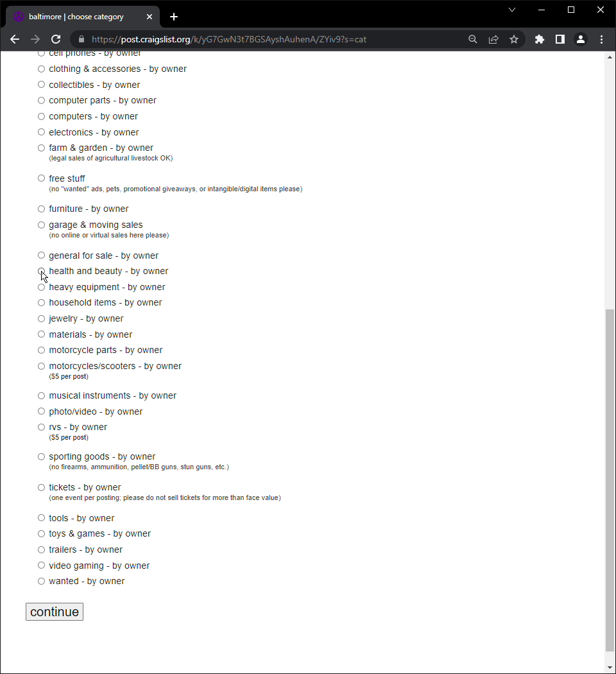
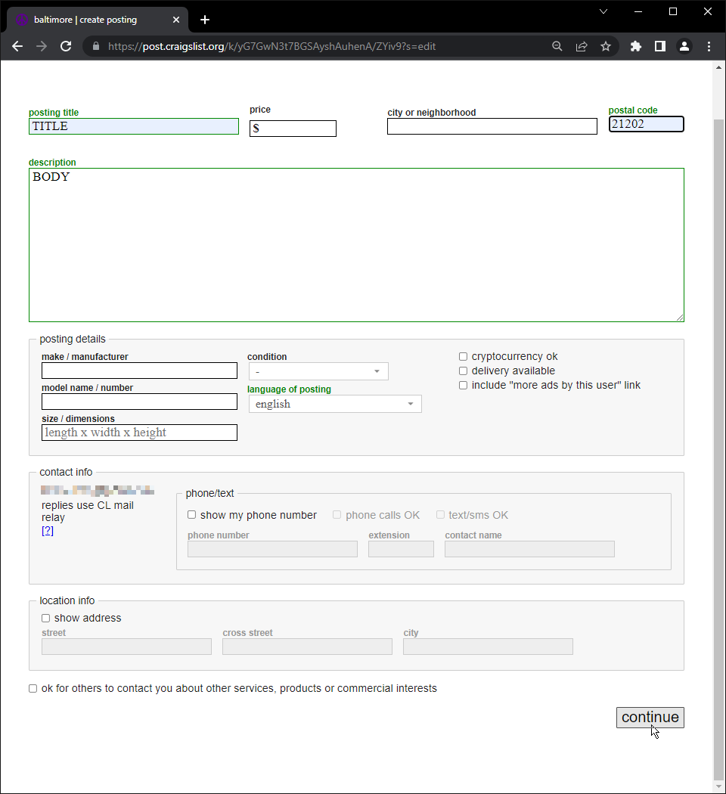
Again, string IDs are different but the ?s=edit structure is the same for the URL generated
7: Form Submit
click

Slide 46
Analyze segment 9 (visits id=16)
7: Form Submit
Visit ID | Date | Description | Duration (in second)
16 | Tue Apr 19 09:58:13 AM EDT 2022 | User filled out the form (description title, price, delivery, etc.) and submitted User needs to choose their location – query bQti5?s=geoverify to verify their geolocation | User stayed in the page for 4 second
Notes:
printf "%x" 805306375
30000007
echo “$((0x30000007 & 0xff))”
7
select "url_id: " || id, url, title from urls where id=12;

Slide 47
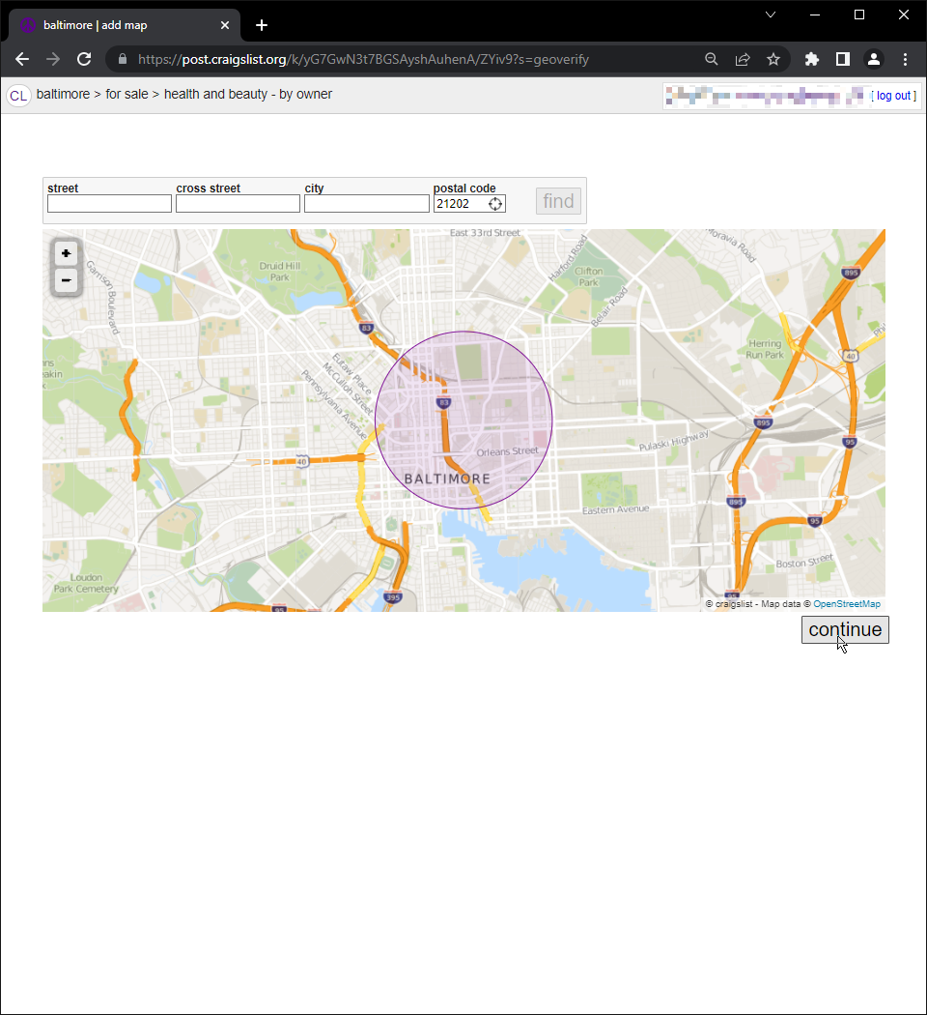
?s=geoverify indicates the “add map” page and choosing a location
filled form
7: Form Submit

Slide 48
Analyze segment 10 (visits id=17)
7: Form Submit
Visit ID | Date | Description | Duration (in second)
17 | Tue Apr 19 09:58:17 AM EDT 2022 | User filled out the form (chose location) and submitted User needs to choose to upload image or not – query bQTi5?s=editimage | User stayed in the page for 1 second
Notes:
printf "%x" 805306375
30000007
echo “$((0x30000007 & 0xff))”
7
select "url_id: " || id, url, title from urls where id=13;

Slide 49
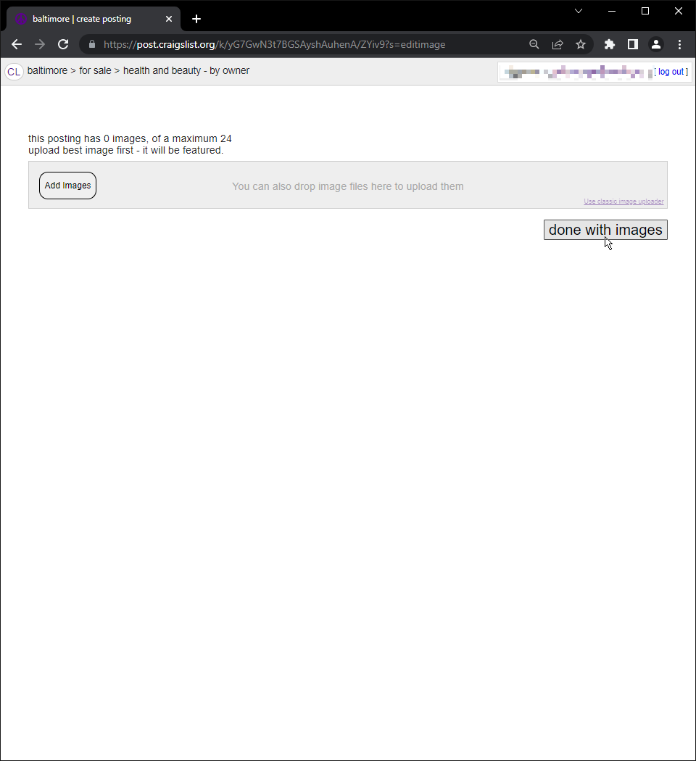
?s=editimage structure indicates the next step in choosing an image
filled form
7: Form Submit

Slide 50
Analyze segment 11 (visits id=18)
7: Form Submit
Visit ID | Date | Description | Duration (in second)
18 | Tue Apr 19 09:58:19 AM EDT 2022 | User filled the form (chose image option), URL doesn’t show if they uploaded an image or not but we can always check the post itself User can edit post, edit location, edit images or publish post in a preview – query bQTi5?s=preview | User stayed in the page for 3 second
Notes:
printf "%x" 805306375
30000007
echo “$((0x30000007 & 0xff))”
7
select "url_id: " || id, url, title from urls where id=14;

Slide 51
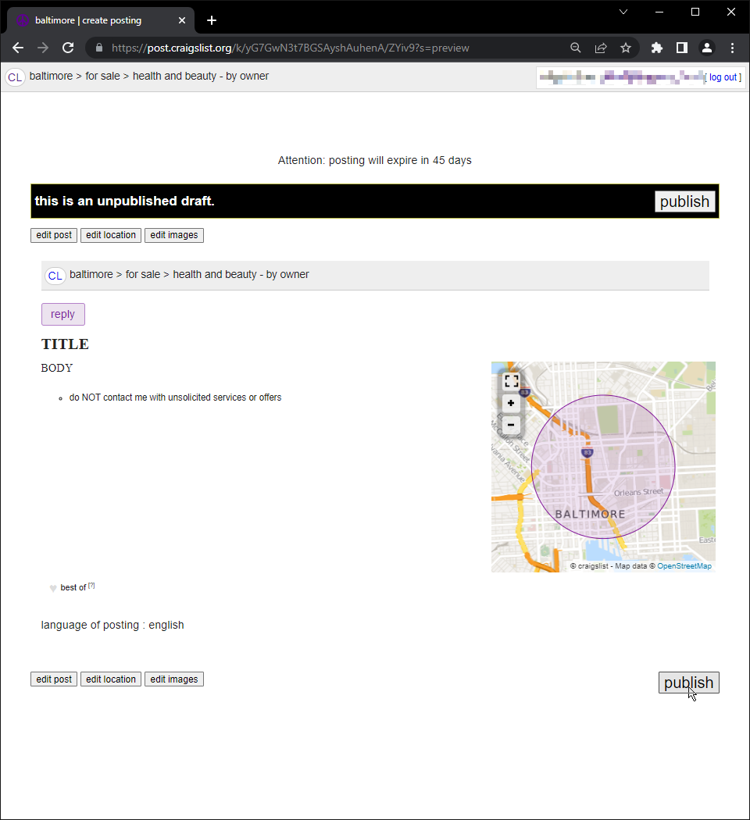
?s=preview structure indicates the next step of preview before publish
7: Form Submit
clicked

Slide 52
Analyze segment 12 (visits id=19)
7: Form Submit
Visit ID | Date | Description | Duration (in second)
19 | Tue Apr 19 09:58:22AM EDT 2022 | User filled the form (selected publish) and submitted User can share, view, or manage post or return to account page | User stayed in the page for 4 second
Notes:
printf "%x" 805306375
30000007
echo “$((0x30000007 & 0xff))”
7
select "url_id: " || id, url, title from urls where id=8;

Slide 53
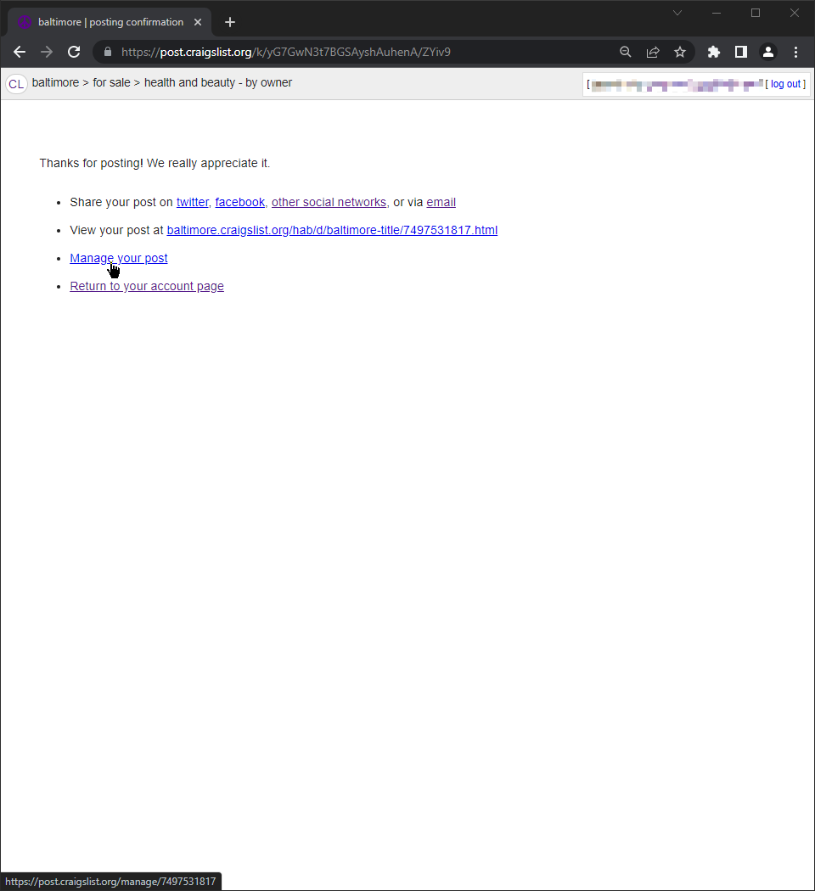
<stringID1>/<stringID2> | posting confirmation structure indicates post was published
7: Form Submit
clicked

Slide 54
Analyze segment 13 (visits id=20)
0: Link
Visit ID | Date | Description | Duration (in second)
20 | Tue Apr 19 09:58:27 AM EDT 2022 | User clicked a link (https://post.craigslist.org/) with path /manage/7473121658 to manage posting User can edit post, update images, edit location, delete post or visit post | User stayed in the page for 5 second
Notes:
printf "%x" 805306368
30000000
echo “$((0x30000000 & 0xff))”
0
select "url_id: " || id, url, title from urls where id=15;

Slide 55
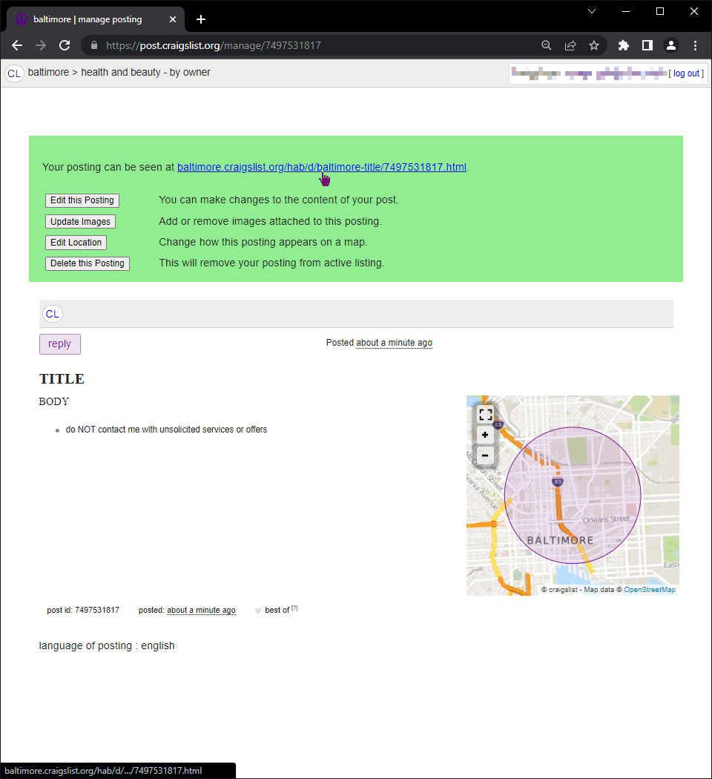
/manage/<stringID> | baltimore | manage posting indicates post published and suspect on management page
0: Link
clicked

Slide 56
Analyze segment 14 (visits id=21-23)
0: Link
5: Omnibar Generated
0: Link
Visit ID | Date | Description | Duration (in second)
21-23 | Tue Apr 19 09:58:31 AM to 09:58:39 AM EDT 2022 | User clicked a link (https://baltimore.craigslist.org/hab/d/baltimore-cheaper-than-rx-supplements/7473121658.html) with path /hab/d/baltimore-cheaper-than-rx-supplements/ to view post 747341212658 Then user typed “gmail” in Chrome address bar and URL was generated to Google Search results | User stayed in the page 17 for .8 second
Notes:
printf "%x" 805306368
30000000
echo “$((0x30000000 & 0xff))”
0
printf "%x" 838860805
32000005
echo “$((0x32000005 & 0xff))”
5
printf "%x" 805306368
30000000
echo “$((0x30000000 & 0xff))”
0
select "url_id: " || id, url, title from urls where id between 16 and 17;

Slide 57
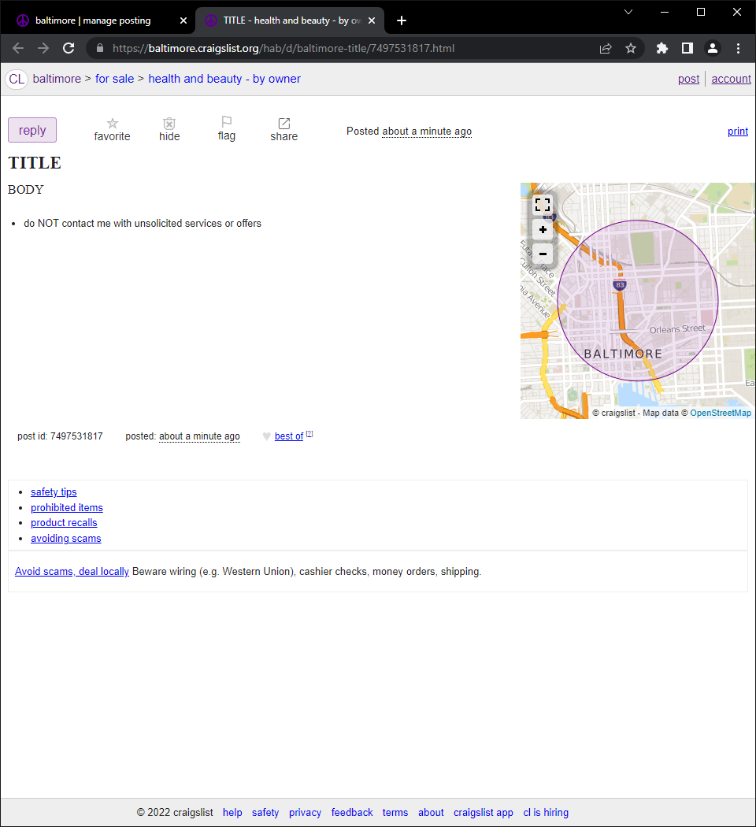
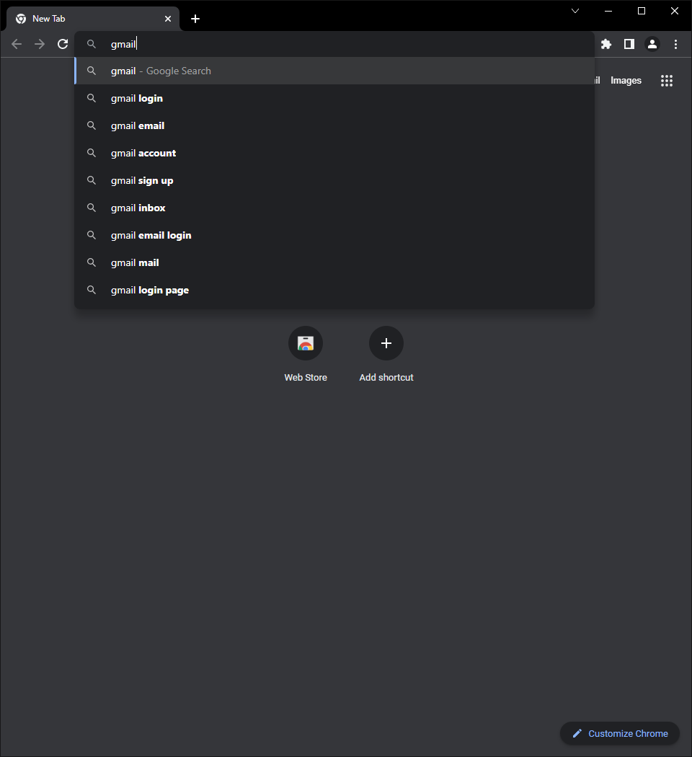
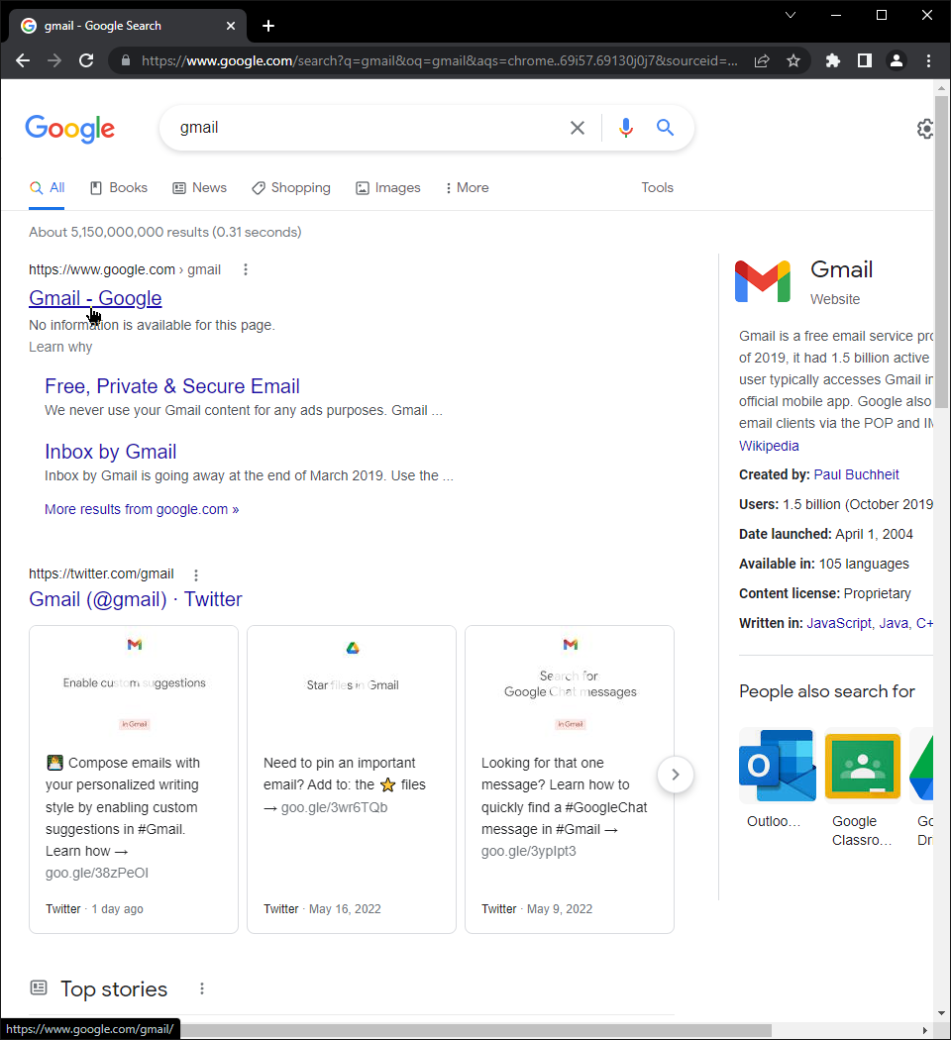
Visit 20
Visit 21
0: Link
clicked
Visit 23
5: Omnibar Generated
Visit 22
typed
0: Link

Slide 58
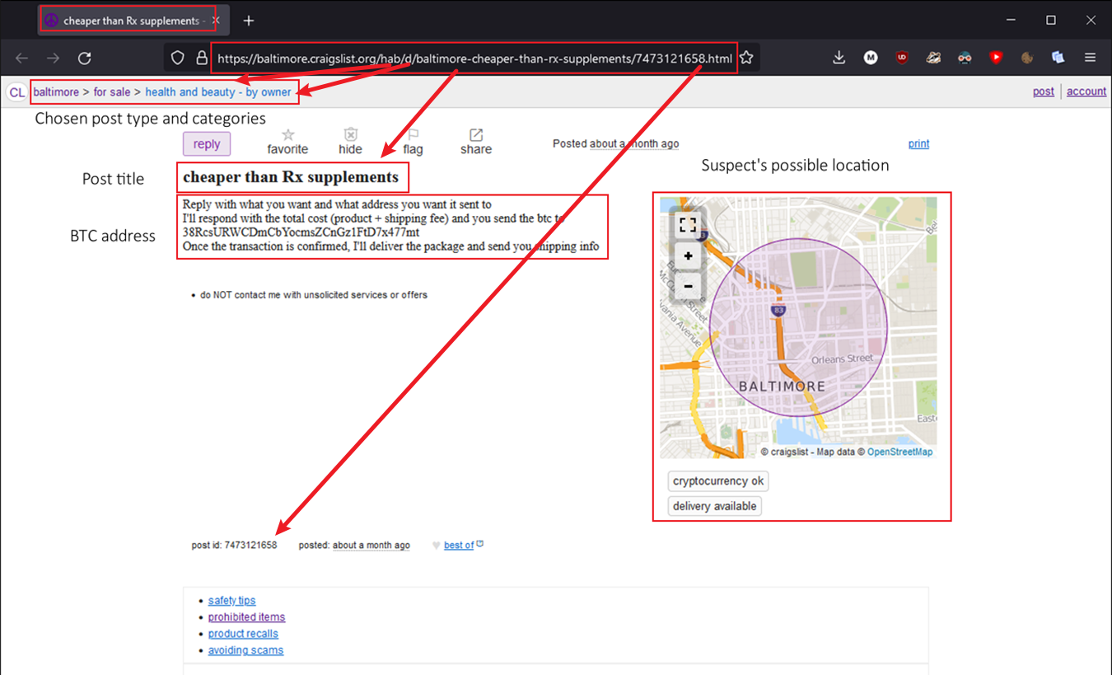
Analyze segment 14 (visit id=21)
Look at the actual post from visit id=21 for more information

Slide 59
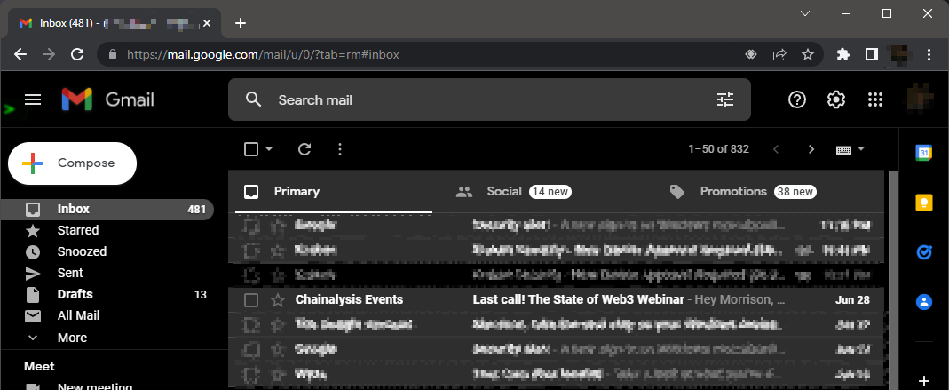
Gmail
Gmail is a free email service provide by Google

Slide 60
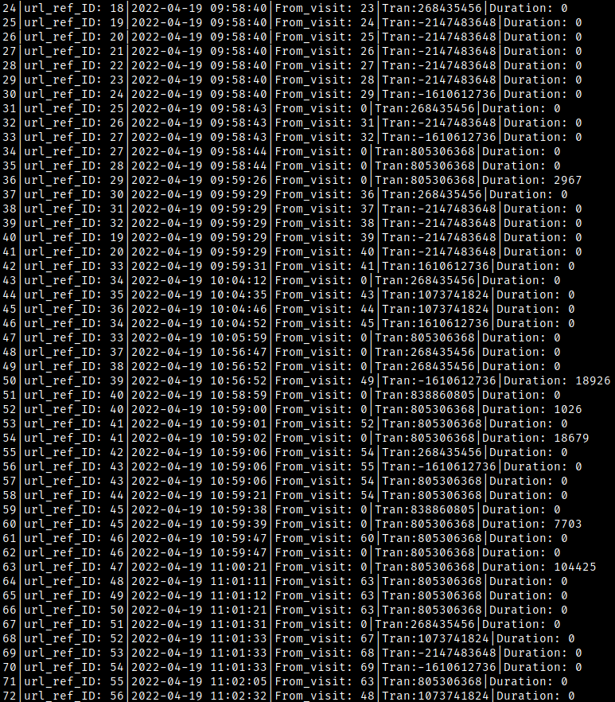
Analyze segment 15 (visits id=24-26)
This segment are google.com to mail.google.com with user inbox loading
0: Link
0: Link and Redirect
0: Link and Redirect
Visit ID | Date | Description | Duration (in second)
24-26 | Tue Apr 19 09:58:40 AM AM EDT 2022 | User clicked a link (https://www.google.com/gmail) to Gmail Then user was redirected to unsub.fscs@gmail.com inbox Then user was redirected to URL containing path /u/0/ indicating user is logged into account 0 | User stayed in the page for 0 second
Notes:
printf "%x" 268435456
10000000
echo “$((0x10000000 & 0xff))”
0
printf "%x" -2147483648
ffffffff80000000
echo “$((0x80000000 & 0xff))”
0
select "url_id: " || id, url, title from urls where id between 18 and 20;

Slide 61
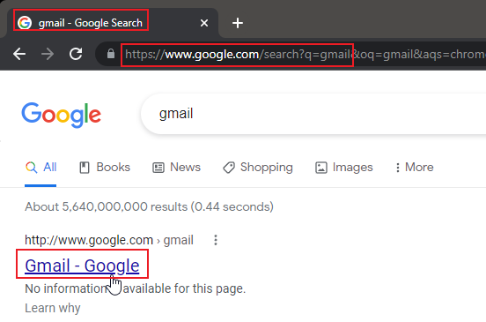
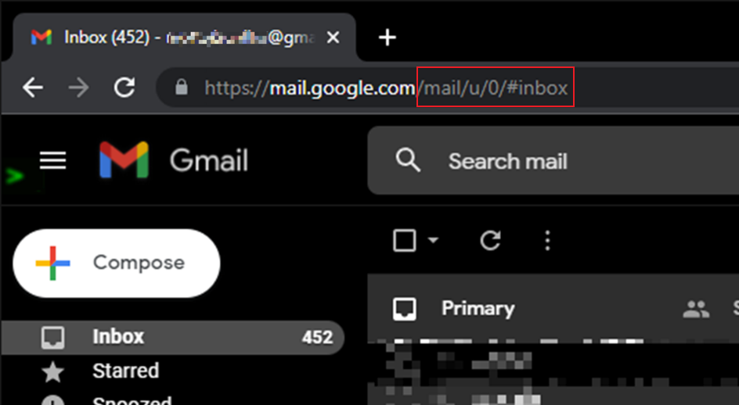
0: Link and Redirect
clicked

Slide 62
Analyze segment 15 part 2 (visits id=27-29)
0: Link and Redirect
0: Link and Redirect
0: Link and Redirect
Visit ID | Date | Description | Duration (in second)
27-29 | Tue Apr 19 09:58:40 AM AM EDT 2022 | User was redirected to accounts.google.com with the URL to their inbox as a parameter to ServiceLogin?service= with https://mail.google.com/mail/u/0 User was then directed to link (https://mail.google.com/) with path /help/about.html on to an about.html page User was then redirected again to another about page with path /help/ to an about.html page | User stayed in the page for 0 second
Notes:
printf "%x" -2147483648
ffffffff80000000
echo “$((0x80000000 & 0xff))”
0
select "url_id: " || id, url, title from urls where id between 27 and 29;

Slide 63
Analyze segment 15 part 3 (visits id=30-32)
This segment are redirects from google.com to accounts.google.com with account being chosen
0: Link
0: Link and Chain Start
0: Link and Redirect
Visit ID | Date | Description | Duration (in second)
30-32 | Tue Apr 19 09:58:40 AM AM to 09:58:43 AM EDT 2022 | User clicked a link (https://www.google.com/) with path /gmail/about/ to Google Workspace Then user clicked a link (https://accounts.google.com/) with path /AccountChooser/ and query siginchooser?service=mail to a login page Then user was redirected to link (https://accounts.google.com) with query AccountChooser?service=mail to choose an account | User stayed in the page for 0 second
Notes:
printf "%x" -1610612736
ffffffffa0000000
echo “$((0xa0000000 & 0xff))”
0
printf "%x" 268435456
10000000
echo “$((0x10000000 & 0xff))”
0
printf "%x" -2147483648
ffffffff80000000
echo “$((0x80000000 & 0xff))”
0
select "url_id: " || id, url, title from urls where id between 24 and 26;

Slide 64

Analyze segment 15 part 4 (visits id=33-36)
This segment are accounts.google.com redirects with account username (identifier) and password (challenge)
0: Link
0: Link
0: Link
0: Link
Visit ID | Date | Description | Duration (in second)
33-36 | Tue Apr 19 09:58:43 AM AM to 09:58:44 AM EDT 2022 | User clicked a link (https://accounts.google.com/) to Gmail with query ServiceLogin?continue= to a login page Then user clicked a link (https://accounts.google.com/) to Gmail with same query (https://accounts.google.com/) to Gmail with path /signin/ with query identifier?continue to a login page prompting identifier email address/username Then user clicked a link (https://accounts.google.com/) with path /signin/challenge/ and query pwd?continue= to a login page prompting challenge password | User stayed in the page 29 for 2 second
Notes:
printf "%x" -1610612736
ffffffffa0000000
echo “$((0xa0000000 & 0xff))”
0
printf "%x" 805306368
30000000
echo “$((0x30000000 & 0xff))”
0
select "url_id: " || id, url, title from urls where id between 27 and 29;

Slide 65

Analyze segment 16 (visits id=37-39)
This segment are accounts.google.com to mail.google.com with cookie checks and authentications
0: Link
0: Link and Redirect
0: Link and Redirect
Visit ID | Date | Description | Duration (in second)
37-39 | Tue Apr 19 09:59:29 AM EDT 2022 | User clicked a link (https://accounts.google.com/) with query CheckCookie?continue= and parameter value loginDoneHtml to unsub.fscs@gmail.com’s inbox Then user was redirected (https://mail.google.com/) with path /accounts/ and query SetOSID?authuser to unsub.fscs@gmail.com’s inbox Then user was redirected (https://accounts.youtube.com/) with path /accounts/ and query SetSID? To unsub.fscs@gmail.com’s inbox | User stayed in the page for 0 second
Notes:
printf "%x“ 268435456
10000000
echo “$((0x10000000 & 0xff))”
0
printf "%x“ -2147483648
ffffffff80000000
echo “$((0x80000000 & 0xff))”
0
select "url_id: " || id, url, title from urls where id between 24 and 26;

Slide 66
Analyze segment 17 part 1(visits id=40-41)
This segment are paths /mail/u/ to /mail/u/0/ to the suspect’s inbox
0: Link
0: Link
Visit ID | Date | Description | Duration (in second)
40-41 | Tue Apr 19 09:59:29 AM EDT 2022 | User clicked a link (https://mail.google.com/) with path /mail/ to unsub.fscs@gmail.com’s inbox User clicked a link (https://mail.google.com/) with path /u/0/ to unsub.fscs@gmail.com’s inbox | User stayed in the page for 0 second
Notes:
printf "%x“ -2147483648
ffffffff80000000
echo “$((0x80000000 & 0xff))”
0
select "url_id: " || id, url, title from urls where id between 19 and 20;

Slide 67

(visits id=27-41)
Unable to screenshot redirects because they happen instantaneously but we can reproduce navigation and compare history
This is as seen using DB Browser for better readability
Our history file
Suspect history file

Slide 68
Analyze segment 17 part 2 (visits id=42-43)
This segment are paths /mail/u/0/inbox# to /mail/u/#inbox/WhctKKXX… the suspect’s inbox and an opened email
0: Link
0: Link and Chain Start
Visit ID | Date | Description | Duration (in second)
42-43 | Tue Apr 19 09:59:31 AM AM to 10:04:12 EDT 2022 | User clicked a link (https://mail.google.com/) with path /mail/u/0/#inbox to unsub.fscs@gmail.com’s inbox User clicked a link (https://mail.google.com/) with string WhctKKXXDrfCq… indicating ID for opened email with subject header cheaper than Rx supplements - order | User stayed in the page for 0 second
Notes:
printf "%x“ 1610612736
6000000
echo “$((0x60000000 & 0xff))”
0
printf "%x“ 268435456
1000000
echo “$((1x60000000 & 0xff))”
0
select "url_id: " || id, url, title from urls where id between 33 and 34;

Slide 69


Structure /mail/u/0/inbox#/<stringID> indicates a specific message was opened
0: Link

Slide 70



0: Link and Chain Start
Clicked and opened a message
Message has its own unique ID
Subject header appears in title

Slide 71
Analyze segment 19 (visits id=44-45)
This segment are two replies being created for the same message WhctKKXXDrf
0: Link and Refresh
0: Link and Refresh
Visit ID | Date | Description | Duration (in second)
44-45 | Tue Apr 19 10:04:35 AM AM to 10:04:46 EDT 2022 | User clicked a link (https://mail.google.com/) with query ?compose=JHrtff referring to open message WhctKKXX with subject header “order” User then clicked a link (https://mail.google.com) with query ?compose=DXDWs referring to same message WhctKKXX indicating two replies were made for the same message | User stayed in the page for 0 second
Notes:
printf "%x“ 1073741824
6000000
echo “$((0x60000000 & 0xff))”
0
select "url_id: " || id, url, title from urls where id between 35 and 36;

Slide 72



Structure <messageID>/?compose=<replyID> indicates replies targeted same message
Message ID referenced in two different replies
0: Link and Refresh
clicked

Slide 73
Analyze segment 20 (visits id=46-48)
This segment includes a new email ID WhcTKKXXDrcfCqvtRJ being opened
0: Link
0: Link
0: Link and Chain Start
Visit ID | Date | Description | Duration (in second)
46-48 | Tue Apr 19 10:04:52 AM AM to 10:04:59 EDT 2022 | User clicked a link (https://mail.google.com/mail/u/0/#inbox) to unsub.fscs@gmail.com’s inbox User clicked a link (https://mail.google.com/mail/u/0/#inbox) with string WhctKKXXDrFCqXBGC “order” message open User clicked a lick (https://mail.google.com/mail/u/0/#inbox) with string WhctKKXXDrfCqvtRj, another new message with subject header “txid: 517b2159…” | User stayed in the page for 0 second
Notes:
printf "%x“ 1610612736
6000000
echo “$((0x60000000 & 0xff))”
0
printf "%x“ 805306368
3000000
echo “$((0x30000000 & 0xff))”
0
printf "%x“ 268435456
1000000
echo “$((0x10000000 & 0xff))”
0
select "url_id: " || id, url, title from urls where id between 33 and 34;
select "url_id: " || id, url, title from urls where id=37;

Slide 74
Analyze segment 21 (visits id=49-50)
0: Link
0: Link
Visit ID | Date | Description | Duration (in second)
49-50 | Tue Apr 19 10:56:52 AM EDT 2022 | User clicked a link (https://www.google.com/) with query url?=https://imgur.com/dTgrkp7 and parameter source=gmail indicating the imgur link originated from a Gmail message User clicked a link (https://imgur.com/dTgrkP7) to imgur post | User stayed in the page 39 for 18 second
Notes:
printf "%x“ 268435456
1000000
echo “$((0x10000000 & 0xff))”
0
printf "%x“ -1610612736
ffffffffa000000
echo “$((0xa0000000 & 0xff))”
0
select "url_id: " || id, url, title from urls where id between 38 and 39;

Slide 75

imgur
Imgur is an online image sharing and hosting service. Images can be uploaded anonymously and shared

Slide 76


Imgur link received in Gmail and opened
0: Link
clicked
In database, you can see the imgur link from message has parameter source=gmail
Strcuture www.google.com/url?q=<imgurlink>&source=gmail indicates imgur links can be opened from within Gmail message

Slide 77


visits id=50
Look at the imgur post – URL does not have enough information about the image post
Message shows Bitcoin was sent
Amount of BTC sent and USD equivalent at time
Suspect’s wallet address from craigslist post
Link to a blockchain explorer
Although we cannot access this specific link, we still have the TXID from email subject header

Slide 78

Blockchain Explorer
Blockchain Explorer is a block and crypto transaction search engine – queries can include wallet addresses and transaction IDs

Slide 79

visits id=50
Using the TXID from the Gmail message we can search it on a Blockchain Explorer to verify authenticity
You will see later the suspect does the same thing!

Slide 80
Analyze segment 22 (visits id=51-52)
This segment is the google search for “blockchain explorer”
5: Form Submit
0: Link
Visit ID | Date | Description | Duration (in second)
51-52 | Tue Apr 19 10:58:59 AM to 10:59:00 EDT 2022 | User typed “blockchain explorer” into Chrome address bar and generated a URL to Google Search results | User stayed in the page for 1 second
Notes:
printf "%x“ 838860805
32000005
echo “$((0x32000005 & 0xff))”
5
printf "%x“ 805306368
30000000
echo “$((0x30000000 & 0xff))”
0
select "url_id: " || id, url, title from urls where id=40;

Slide 81


Suspect typed “blockchain explorer”
typed
5: Form Submit

Slide 82

Structure www.google.com/search?=q<string1>+<string2> indicates a Google search result page
typed
0: Link

Slide 83
Analyze segment 23 (visits id=53-54)
This segment is the transition to blockchain.com
0: Link
0: Link
Visit ID | Date | Description | Duration (in second)
53-54 | Tue Apr 19 10:59:01 AM to 10:59:02 EDT 2022 | User clicked a link (https://www.blockchain.com/explorer) to Blockchain Explorer | User stayed in the page for 18 second
Notes:
printf "%x“ 805306368
30000000
echo “$((0x30000000 & 0xff))”
0
select "url_id: " || id, url, title from urls where id=41;

Slide 84

Suspected clicked www.blockchain.com link and taken to /explorer path
clicked
0: Link

Slide 85
Analyze segment 24 (visits id=55-57)
This segment are the transitions from a search on blockchain.com
0: Link and Chain Start
0: Link
0: Link
Visit ID | Date | Description | Duration (in second)
55-57 | Tue Apr 19 10:59:06 AM EDT 2022 | User clicked a link (https://www.blockchain.com/) with query ?search= value 517b215… then a URL was generated User then clicked a link (https://blockchain.com/) with path /btc/tx and string matching 517b215 transaction to view the transaction | User stayed in the page for 0 second
Notes:
printf "%x“ 268435456
10000000
echo “$((0x10000000 & 0xff))”
0
printf "%x“ -1610612736
fffffffa000000
echo “$((0xa0000000 & 0xff))”
0
printf "%x“ 805306368
30000000
echo “$((0x30000000 & 0xff))”
0
select "url_id: " || id, url, title from urls where id between 42 and 43;

Slide 86


Enter text and clicking search not considered as a Form Submit transition in this case
0: Link and Chain Start

Slide 87

Suspect entered (we don’t know specifically) TXID and clicked search then transitioned to /tx/517b… transaction page
clicked
0: Link
Structure www.blockchain.com/tx/<TXID> indicates a specific transcation page

Slide 88
Analyze segment 25 (visits id=58)
This segment is a transition from the transaction to a wallet address
0: Link and Chain Start
Visit ID | Date | Description | Duration (in second)
58 | Tue Apr 19 10:59:21 AM EDT 2022 | User clicked a link (https://www.blockchain.com) with path /btc/address/ and string 38RcsURW… to the suspect’s address | User stayed in the page for 0 second
Notes:
printf "%x“ 805306368
30000000
echo “$((0x30000000 & 0xff))”
0
select "url_id: " || id, url, title from urls where id=44;

Slide 89


Suspect clicked on their wallet address from transaction page and transition to address page
0: Link and Chain Start
clicked
Structure www.blockchain.com/btc/address/<addressID> indicates a Bitcoin address page

Slide 90


We can use url_id=44 and search for the suspect’s wallet address and correlate with the buyer’s receipt on imgur
We can use a price tracker to estimate price at time of transaction
This also suggests that the imgur post is receipt of this transaction since BTC values same
As of 05/25/2022 this is $3.48

Slide 91
Analyze segment 26 (visits id=59-60)
5: Form Submit
0: Link
Visit ID | Date | Description | Duration (in second)
59-60 | Tue Apr 19 10:59:38 AM to 10:59:39 AM EDT 2022 | User typed “kraken” into Chrome address bar and generated a URL to Google Search results | User stayed in the page for 7 second
Notes:
printf "%x“ 838860805
32000005
echo “$((0x32000005 & 0xff))”
5
printf "%x“ 805306368
30000000
echo “$((0x30000000 & 0xff))”
0
select "url_id: " || id, url, title from urls where id=45;

Slide 92

Kraken
Kraken is a cryptocurrency exchange and banking platform

Slide 93

Suspect typed “kraken” into Google searchh
typed
5: Form Submit

Slide 94

Suspect typed “kraken” into Google search
Transitioned to results page
typed
0: Link

Slide 95
Analyze segment 27 (visits id=61-62)
This segment is a transition from Google search results to www.kraken.com
0: Link
0: Link
Visit ID | Date | Description | Duration (in second)
61-62 | Tue Apr 19 10:59:47 AM EDT 2022 | User clicked link (https://kraken.com/) with path /en-us/sign-in to Kraken Sign in page | User stayed in the page for 0 second
Notes:
printf "%x“ 805306368
30000000
echo “$((0x30000000 & 0xff))”
0
select "url_id: " || id, url, title from urls where id=46;

Slide 96


clicked
0: Link

Slide 97

Analyze segment 28 (visits id=63-65)
This segment are transitions for suspect authenticating device login and successfully logging in
0: Link
0: Link
0: Link
Visit ID | Date | Description | Duration (in second)
63-65 | Tue Apr 19 11:00:21 AM to 11:01:12 AM EDT 2022 | User clicked a link (https://www.kraken.com) with path /en-us/device-approval to approve signing in from new device User then clicked a link (https://www.kraken.com) with path /u/ and query trade?i=true after successfully signing in User then clicked a link (https://www.kraken.com) with path /u/instant | User stayed in the page for 104 seconds or 1.7 minutes
Notes:
printf "%x“ 805306368
30000000
echo “$((0x30000000 & 0xff))”
0
select "url_id: " || id, url, title from urls where id=47-49;

Slide 98


Suspect typed user information
0: Link
clicked

Slide 99

Suspect used whatever associated email service to approve device
0: Link
Structure www.kraken.com/u/instant and title indicates suspect successfully logged in and transitioned to trading page

Slide 100
Analyze segment 29 (visits id=66)
This segment is the transition from the trading page to the funding page
0: Link
Visit ID | Date | Description | Duration (in second)
66 | Tue Apr 19 11:00:21 AM EDT 2022 | User clicked a link (https://www.kraken.com) with path /u/funding to Funding page | User stayed in the page for 0 seconds
Notes:
printf "%x“ 805306368
30000000
echo “$((0x30000000 & 0xff))”
0
select "url_id: " || id, url, title from urls where id=47-49;

Slide 101


Suspect clicked “Funding” link
clicked
0: Link
Structure www.kraken.com/u/funding and title indicate suspect transitioned to funding page

Slide 102

Analyze segment 30 (visits id=67-70)
This segment are the redirects from www.kraken.com to the TXID on mempool.space
0: Link and Chain Start
0: Link and Refresh
0: Link and Redirect
0: Link and Redirect
Visit ID | Date | Description | Duration (in second)
67-70 | Tue Apr 19 11:01:31 AM to 11:01:33 AM EDT 2022 | User clicked a link (https://www.kraken.com) with query redirect?url= pointing to https://mempool.space/tx/517b21... Then page is refreshed by server Then refresh page is redirected to link (https://www.kraken.com) with query redirect? and title Transaction: 517b21.. Then redirected to link (https://mempool.space) with path /tx/517b21… | User stayed in the page for 0 seconds
Notes:
printf "%x“ 268435456
10000000
echo “$((0x10000000 & 0xff))”
0
printf "%x“ 1073741824
40000000
echo “$((0x40000000 & 0xff))”
0
printf "%x“ -2147483648
ffffffff80000000
echo “$((0x80000000 & 0xff))”
0
printf "%x“ -1610612736
ffffffffa0000000
echo “$((0x80000000 & 0xff))”
0
select "url_id: " || id, url, title from urls where id=51-54

Slide 103

mempool space
mempool space is similar to Blockchain Explorer, allowing search of BTC transaction, address history, and transaction status

Slide 104

Clicking on the transaction opens a window without transitioning pages, therefore, it will not appear in history database
clicked

Slide 105

Refreshes and redirects could not be screenshotted because they are instantaneous
0: Link and Redirect
clicked
Structure mempool.space/tx/<TXID> indicates transition to the suspect-buyer transaction

Slide 106
Analyze segment 31 (visits id=71)
This segment is the transition from the mempool.space page to Kraken History Ledger page
0: Link
Visit ID | Date | Description | Duration (in second)
71 | Tue Apr 19 11:02:05 AM EDT 2022 | User clicked a link (https://www.kraken.com) with path /u/history/ledger to Kraken History Ledger page | User stayed in the page for 0 seconds
Notes:
printf "%x“ 268435456
30000000
echo “$((0x30000000 & 0xff))”
0
select "url_id: " || id, url, title from urls where id=55;

Slide 107


Closing this window will not change the URL or any entries in the history database but must be done to continue
clicked

Slide 108

Suspect clicked History link
clicked
0: Link
Structure www.kraken.com/u/history/ledger indicates transition to Ledger page

Slide 109

Analyze segment 32 (visits id=72-73)
This segment are the transitions back to suspect’s Gmail inbox and another two replies being composed to one message
0: Link and Refresh
Visit ID | Date | Description | Duration (in second)
72-73 | Tue Apr 19 11:02:05 AM to 11:02:44 AM EDT 2022 | User clicked a link (https://mail.google.com) with path /u/0/#inbox with string pointing to WhctKKXXdrfC… message with subject “order” and query ?compose=JhrtffdgkF… as one reply to the message User then clicked a link (https://mail.google.com) with same path pointing to same WhctKKXXdrfC… message but with another reply xQTrpQHKf… | User stayed in the page for 0 seconds
Notes:
printf "%x“ 1073741824
40000000
echo “$((0x40000000 & 0xff))”
0
select "url_id: " || id, url, title from urls where id=55;

Slide 110



Like before, suspect opened a message and created two replies
0: Link and Refresh

Slide 111
Analyze segment 33 (visits id=74)
This segment is a transition back to the earlier message “WhctKKXXDrf”/”order” from visit id=48
0: Link and Refresh
Visit ID | Date | Description | Duration (in second)
74 | Tue Apr 19 11:02:05 AM EDT 2022 | User clicked a link (https://mail.google.com) with path /mail/u/0/#inbox/ with string WhctKKXXDRf message with subject header txid from earlier visit id=48 | User stayed in the page for 0 seconds
Notes:
printf "%x“ 1610612736
60000000
echo “$((0x60000000 & 0xff))”
0
select "url_id: " || id, url, title from urls where id=37;

Slide 112
Analyze id=1 in downloads table
There is a download (download id=1) between the imgur visit (visit id=50) and blockchain (visit id=51) google search
The imgur post was a BTC receipt, so it makes sense buyer downloaded the image as proof_of_payment.png for records

Slide 113
Materials of Interest
Matieral | Description/Value | Value
Possible Suspect Location | Baltimore Region | Narrows search area
Suspect/Dealer-Buyer TXID | 517b2156914944339a96137ad8978408ea52b2fc144c98d3b0b16b21888afdc5 | Allows us to create a paper trail for transaction
Suspect BTC Wallet Address | 38RcsURWCDmCbYocmsZCnGz1FtD7x477mt | Can monitor BTC address
Suspect Email Address | unsub.fscs@gmail.com | Can monitor email address
Downloaded File | proof_of_payment.png | Connects receipt of transaction to suspect
Downloads File Location | C:\Users\FSCS_User\Desktop\ | Gives us an idea of suspect’s device file structure
Chrome History File Location | C:\Users\FSCS_User\Local\Google\Chrome\User Data\Default\

Slide 114
Confirming Hypothesis with Timeline

Slide 115
Suspected drug dealer posted ad on a website listing sale of illegal drugs
Visits grouped based on hypothesis stage
Visit ID | Date | Description | Duration (in second)
1 | Tue Apr 19 09:54:18 AM EDT 2022 | User typed “craiglist” into Chrome address bar and generate a URL | 0 (indicate a redirect)
2 | Tue Apr 19 09:54:19 AM EDT 2022 | Without any delay (duration =0), Chrome sends the URL to Google and google returns results in web page with the title “craigslist - Google Search” | User stayed in the page for 0.727 second
3-5 | Tue Apr 19 09:54:19 AM EDT 2022 | User clicked a the link (from visits.id=2) and visited https://www.craigslist.org/. However, it was redirected to |https://geo.craigslist.org/ and https://baltimore.craigslist.org/ | User stayed in the page https://baltimore.craigslist.org/ for 2.465 second
6-7 | Tue Apr 19 09:54:22 AM EDT 2022 | User click an account link https://accounts.craigslist.org/login/home in order to log in. User was redirected to another link https://accounts.craigslist.org/login?rp=%2Flogin%2Fhome&rt=L | User stayed in the page |https://post.craigslist.org/c/bal for 17 second
8 | Tue Apr 19 09:54:39 AM EDT 2022 | User filled out the form and submit | User stayed in the page for 23 second

Slide 116
Suspected drug dealer posted ad on a website listing sale of illegal drugs
Visit ID | Date | Description | Duration (in second)
9-10 | Tue Apr 19 09:55:03 AM EDT 2022 | User clicked a link https://www.craigslist.org/ and was redirected to https://baltimore.craigslist.org/ | User stayed in the page for 24 second
11-13 | Tue Apr 19 09:55:05 AM EDT 2022 | User clicked a link (create a posting) https://post.craigslist.org/c/bal User was redirect to url_id 8 and then url_id 9 | User stayed in the page url_id 9 for 4 second
14 | Tue Apr 19 09:55:10 AM EDT 2022 | User filled out the form (chosen types) and submit it User needs to choose category | User stayed in the page for 5 second
15 | Tue Apr 19 09:55:15 AM EDT 2022 | User filled out the form (select category) and submit it User needs to add information (description, title, price, delivery, etc.) | User stayed in the page for 17 second
16 | Tue Apr 19 09:58:13 AM EDT 2022 | User filled out the form (description title, price, delivery, etc.) User needs to choose their location | User stayed in the page for 4 second
17 | Tue Apr 19 09:58:17 AM EDT 2022 | User filled out the form (chose location) User needs to choose to upload image or not | User stayed in the page for 1 second
18 | Tue Apr 19 09:58:19 AM EDT 2022 | User filled the form (chose image option), URL doesn’t show if they uploaded an image or not but we can always check the post itself User can edit post, edit location, edit images or publish post | User stayed in the page for 3 second
Seg 12
19 | Tue Apr 19 09:58:22AM EDT 2022 | User filled the form (selected publish) User can share, view, or manage post or return to account page | User stayed in the page for 4 second

Slide 117
Suspected drug dealer posted ad on a website listing sale of illegal drugs
Visit ID | Date | Description | Duration (in second)
20 | Tue Apr 19 09:58:27 AM EDT 2022 | User clicked a link (https://post.craigslist.org/manage/7473121658|baltimore) to manage the post User can edit post, update images, edit location, delete post or visit post | User stayed in the page for 5 second
21-23 | Tue Apr 19 09:58:31 AM tp 09:58:31 AM to 09:58:39 AM EDT 2022 | User clicked a link (https://baltimore.craigslist.org/hab/d/baltimore-cheaper-than-rx-supplements/7473121658.html) to view post Then user typed “gmail” in Chrome address bar and URL was generated to Google Search results | User stayed in the page 17 for .8 second

Slide 118
2. Interested buyer messaged dealer
Visit ID | Date | Description | Duration (in second)
24-26 | Tue Apr 19 09:58:40 AM AM EDT 2022 | User clicked a link (https://www.google.com/gmail) to Gmail Then user was redirected to unsub.fscs@gmail.com inbox Then user was redirected to URL containing path /u/0/ indicating user is logged into account 0 | User stayed in the page for 0 second
27-29 | Tue Apr 19 09:58:40 AM AM EDT 2022 | User was redirected to accounts.google.com with the URL to their inbox as a parameter to ServiceLogin?service= User was then directed to about page /help/about.html on mail.google.com User was then redirected again to another about page /help.about.html on google.com | User stayed in the page for 0 second
30-32 | Tue Apr 19 09:58:40 AM AM to 09:58:43 AM EDT 2022 | User clicked a link (https://www.google.com/gmail/About/) to Google Workspace Then user clicked a link (https://accounts.google.com/AccountChooser/) with query /siginchooser?service=mail to a login page Then user was redirected to accounts.google.com with query AccountChooser?service=mail to choose an account | User stayed in the page for 0 second

Slide 119
2. Interested buyer messaged dealer
Visit ID | Date | Description | Duration (in second)
33-36 | Tue Apr 19 09:58:43 AM AM to 09:58:44 AM EDT 2022 | User clicked a link (https://accounts.google.com/) to Gmail with query ServiceLogin?continue= to a login page Then user clicked a link (https://accounts.google.com/) to Gmail with same query (https://accounts.google.com/) to Gmail with path /signin/ with query identifier?continue to a login page prompting identifier email address/username Then user clicked a link (https://accounts.google.com/) with path /signin/challenge/ and query pwd?continue= to a login page prompting challenge password | User stayed in the page 29 for 2 second
37-39 | Tue Apr 19 09:59:29 AM EDT 2022 | User clicked a link (https://accounts.google.com/) with query CheckCookie?continue= and parameter value loginDoneHtml to unsub.fscs@gmail.com’s inbox Then user was redirected (https://mail.google.com/) with path /accounts/ and query SetOSID?authuser to unsub.fscs@gmail.com’s inbox Then user was redirected (https://accounts.youtube.com/) with path /accounts/ and query SetSID? To unsub.fscs@gmail.com’s inbox | User stayed in the page for 0 second

Slide 120
2. Interested buyer messaged dealer
Visit ID | Date | Description | Duration (in second)
40-41 | Tue Apr 19 09:59:29 AM EDT 2022 | User clicked a link (https://mail.google.com/) with path /mail/ to unsub.fscs@gmail.com’s inbox User clicked a link (https://mail.google.com/) with path /u/0/ to unsub.fscs@gmail.com’s inbox | User stayed in the page for 0 second
42-43 | Tue Apr 19 09:59:31 AM AM to 10:04:12 EDT 2022 | User clicked a link (https://mail.google.com/) with path /mail/u/0/#inbox to unsub.fscs@gmail.com’s inbox User clicked a link (https://mail.google.com/) with string WhctKKXXDrfCq… indicating ID for opened email with subject header cheaper than Rx supplements - order | User stayed in the page for 0 second

Slide 121
3. Dealer replied with transaction details (Bitcoin wallet)
Visit ID | Date | Description | Duration (in second)
44-45 | Tue Apr 19 10:04:35 AM AM to 10:04:46 EDT 2022 | User clicked a link (https://mail.google.com/) with query ?compose=JHrtff referring to open message WhctKKXX with subject header “order” User then clicked a link (https://mail.google.com) with query ?compose=DXDWs referring to same message WhctKKXX indicating two replies were made for the same message | User stayed in the page for 0 second

Slide 122
4. Buyer sent payment
Visit ID | Date | Description | Duration (in second)
46-48 | Tue Apr 19 10:04:52 AM AM to 10:04:59 EDT 2022 | User clicked a link (https://mail.google.com/mail/u/0/#inbox) to unsub.fscs@gmail.com’s inbox User clicked a link (https://mail.google.com/mail/u/0/#inbox) with string WhctKKXXDrFCqXBGC “order” message open User clicked a lick (https://mail.google.com/mail/u/0/#inbox) with string WhctKKXXDrfCqvtRj, another new message with subject header “txid: 517b2159…” | User stayed in the page for 0 second

Slide 123
5. Dealer confirmed payment
Visit ID | Date | Description | Duration (in second)
49-50 | Tue Apr 19 10:56:52 AM EDT 2022 | User clicked a link (https://www.google.com/) with query url?=https://imgur.com/dTgrkp7 and parameter source=gmail indicating the imgur link originated from a Gmail message User clicked a link (https://imgur.com/dTgrkP7) to imgur post | User stayed in the page 39 for 18 second
51-52 | Tue Apr 19 10:58:59 AM to 10:59:00 EDT 2022 | User typed “blockchain explorer” into Chrome address bar and generated a URL to Google Search results | User stayed in the page for 1 second
53-54 | Tue Apr 19 10:59:01 AM to 10:59:02 EDT 2022 | User clicked a link (https://www.blockchain.com/explorer) to Blockchain Explorer | User stayed in the page for 18 second

Slide 124
5. Dealer confirmed payment
Visit ID | Date | Description | Duration (in second)
55-57 | Tue Apr 19 10:59:06 AM EDT 2022 | User clicked a link (https://www.blockchain.com/) with query ?search= value 517b215… then a URL was generated User then clicked a link (https://blockchain.com/) with path /btc/tx and string matching 517b215 transaction to view the transaction | User stayed in the page for 0 second
58 | Tue Apr 19 10:59:21 AM EDT 2022 | User clicked a link (https://www.blockchain.com) with path /btc/address/ and string 38RcsURW… to the suspect’s address | User stayed in the page for 0 second
59-60 | Tue Apr 19 10:59:38 AM to 10:59:39 AM EDT 2022 | User typed “kraken” into Chrome address bar and generated a URL to Google Search results | User stayed in the page for 7 second
61-62 | Tue Apr 19 10:59:47 AM EDT 2022 | User clicked link (https://kraken.com/) with path /en-us/sign in to Kraken Sign in page | User stayed in the page for 0 second
63-65 | Tue Apr 19 11:00:21 AM to 11:01:12 AM EDT 2022 | User clicked a link (https://www.kraken.com) with path /en-us/device-approval to approve signing in from new device User then clicked a link (https://www.kraken.com) with path /u/ and query trade?i=true after successfully signing in User then clicked a link (https://www.kraken.com) with path /u/instant | User stayed in the page for 104 seconds or 1.7 minutes

Slide 125
5. Dealer confirmed payment
Visit ID | Date | Description | Duration (in second)
66 | Tue Apr 19 11:00:21 AM EDT 2022 | User clicked a link (https://www.kraken.com) with path /u/funding to Funding page | User stayed in the page for 0 seconds
67-70 | Tue Apr 19 11:01:31 AM to 11:01:33 AM EDT 2022 | User clicked a link (https://www.kraken.com) with query redirect?url= pointing to https://mempool.space/tx/517b21... Then page is refreshed by server Then refresh page is redirected to link (https://www.kraken.com) with query redirect? and title Transaction: 517b21.. Then redirected to link (https://mempool.space) with path /tx/517b21… | User stayed in the page for 0 seconds
71 | Tue Apr 19 11:02:05 AM EDT 2022 | User clicked a link (https://www.kraken.com) with path /u/history/ledger to Kraken History Ledger page | User stayed in the page for 0 seconds

Slide 126
6-7. Dealer shipped drugs and buyer received drugs
Visit ID | Date | Description | Duration (in second)
72-73 | Tue Apr 19 11:02:05 AM to 11:02:44 AM EDT 2022 | User clicked a link (https://mail.google.com) with path /u/0/#inbox with string pointing to WhctKKXXdrfC… message with subject “order” and query ?compose=JhrtffdgkF… as one reply to the message User then clicked a link (https://mail.google.com) with same path pointing to same WhctKKXXdrfC… message but with another reply xQTrpQHKf… | User stayed in the page for 0 seconds
74 | Tue Apr 19 11:02:05 AM EDT 2022 | User clicked a link (https://mail.google.com) with path /mail/u/0/#inbox/ with string WhctKKXXDRf message with subject header txid from earlier visit id=48 | User stayed in the page for 0 seconds

